Slide 1
What would happen if every human suddenly disappeared?
Global warming would continue for another 40 years
Satellites would fall out of the sky
Vegetation would take over the land
Nuclear power plants would explode

Slide 2
What would happen if every human suddenly disappeared?
Global warming would continue for another 40 years
Satellites would fall out of the sky
Vegetation would take over the land
Nuclear power plants would explode
https://www.youtube.com/watch?v=EWXdTwFHETA&ab_channel=WhatIf

Slide 3
We are all connected
Everything on earth is connected in one way or another
The earth’s resources are limited; because we live in such an urbanized setting, we often forget where our food and materials come from

Slide 4
Earth Science I
Living vs Non-living Organisms
Limiting Factors
Carrying Capacity
Earth’s Spheres

Slide 5
Living and Non-Living Organisms
An individual living thing (like an animal or a plant) is called an organism. In order to be classified as a living organism, these individuals must display all of the following characteristics:
Made up of one or more cells
Respond to stimuli in their environment
Need energy
Move (at a cellular level)
Grow
Reproduce
Eliminate waste

Slide 6
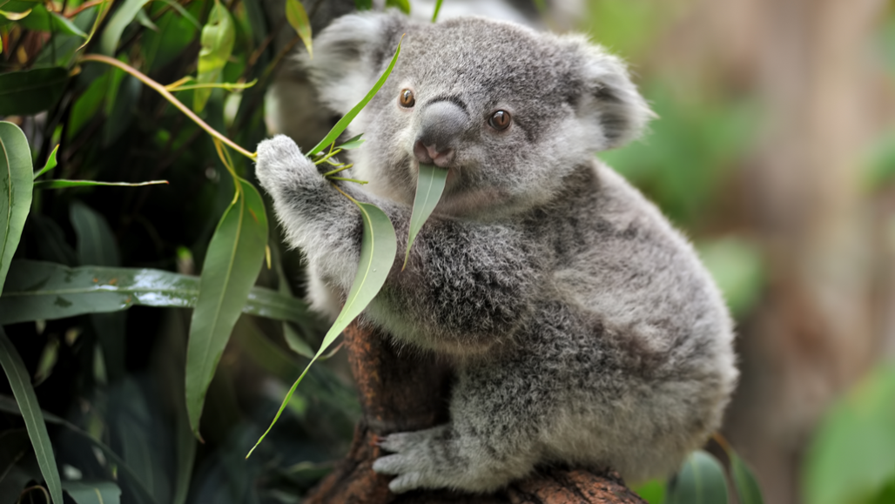
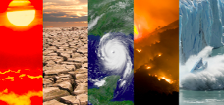
Living and Non-Living Organisms
In an environment, there will be a mixture of both living and non-living things.
Living parts of an environment are called biotic
Non-living parts of an environment are called abiotic
Both biotic and abiotic factors are important within an environment. Biotic and abiotic parts of an environment are connected through ways that they interact with one another.

Slide 7
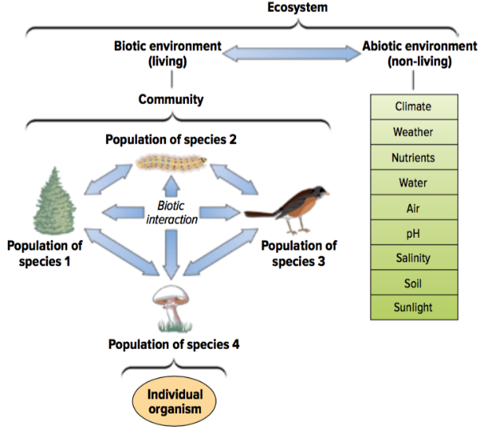
Living and Non-Living Organisms

Slide 8
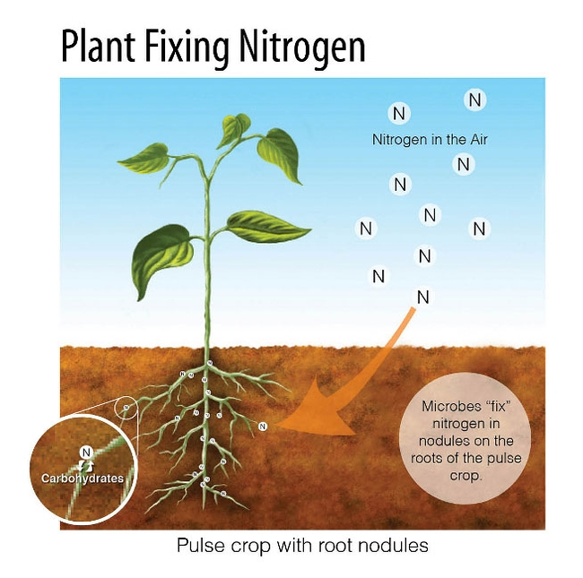
Why are abiotic factors important?
Abiotic factors help the biotic factors survive in their environment.
Example:
Oxygen allows animals to breathe
Rocks help fish hide
Water gives fish a home

Slide 9
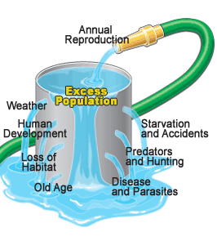
Limiting Factors
Limiting factors are factors that control how large a population can be in its environment.
These factors can be either living or non-living factors.
Limiting factors usually occur when there is a lack of a particular resource

Slide 10
Limiting Factors
Example:
If there is not enough food for predators, food becomes a limiting factor
If there is not enough space for a large number of deer in an environment, space becomes a limiting factor
If there is not enough sunlight for plants to photosynthesize, sunlight will become a limiting factor

Slide 11
Carrying Capacity
Limiting factors will determine the carrying capacity of a population within an environment. Carrying capacity is the average number of organisms an environment can support. It can be referred to as the average population size in a habitat.
The population size can be limited by environmental factors such as amount of food, space for shelter, amount of available mates, etc. (limiting factors)

Slide 12
Carrying Capacity
Example:
A piece of land can support a maximum amount of 10 animals.
Scenario 1: The population is at 20 animals. These animals will starve as there is not enough food
Scenario 2: The population is at 9 animals. These animals will eat well.
Scenario 3: The population is at 10 animals. These animals can eat enough to survive.
Scenario 4: The population is at 11 animals. These animals will starve some and the environment degrades which causes the carrying capacity to reduce. This can eventually cause starvation.

Slide 13
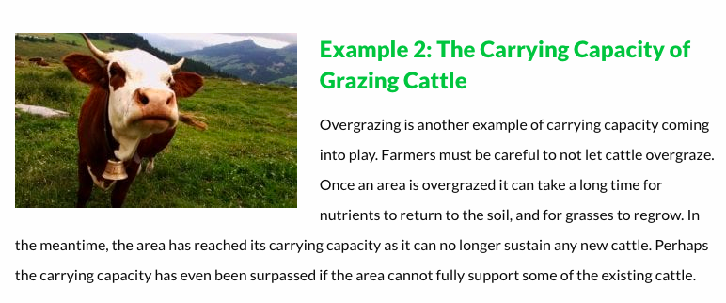
https://populationeducation.org/4-examples-of-carrying-capacity-when-a-population-hits-its-limit/

Slide 14
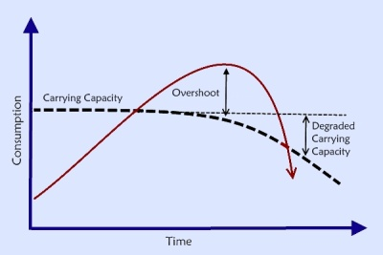
Some key terms:
Carrying Capacity: The largest population an area can support with its resources (i.e. food, water, land)
Overshoot period: When the population in an environment exceeds (goes over) the carrying capacity.
Degrading Carrying Capacity: This will occur when the resources in an environment is destroyed or degraded (deteriorate; break down) which will then lower the carrying capacity.

Slide 15
Video
https://www.youtube.com/watch?v=ysa5OBhXz-Q&ab_channel=SustainableHuman

Slide 16
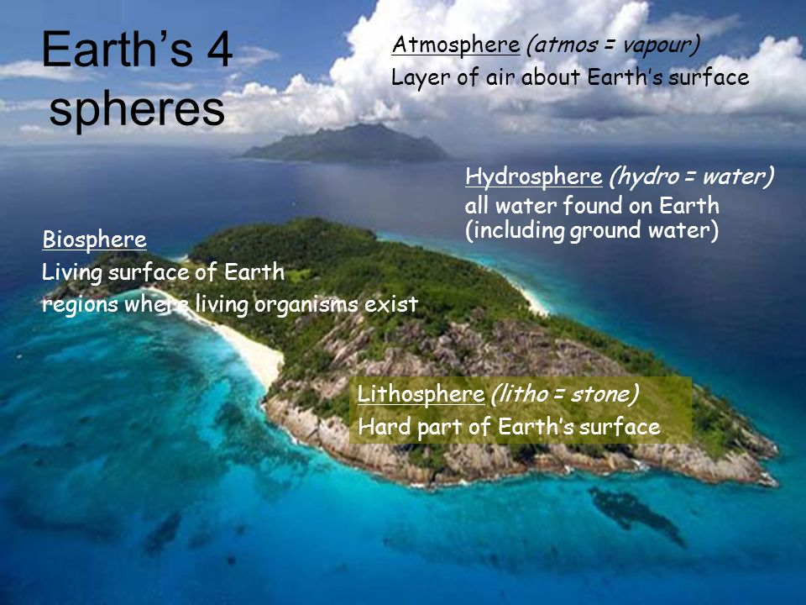
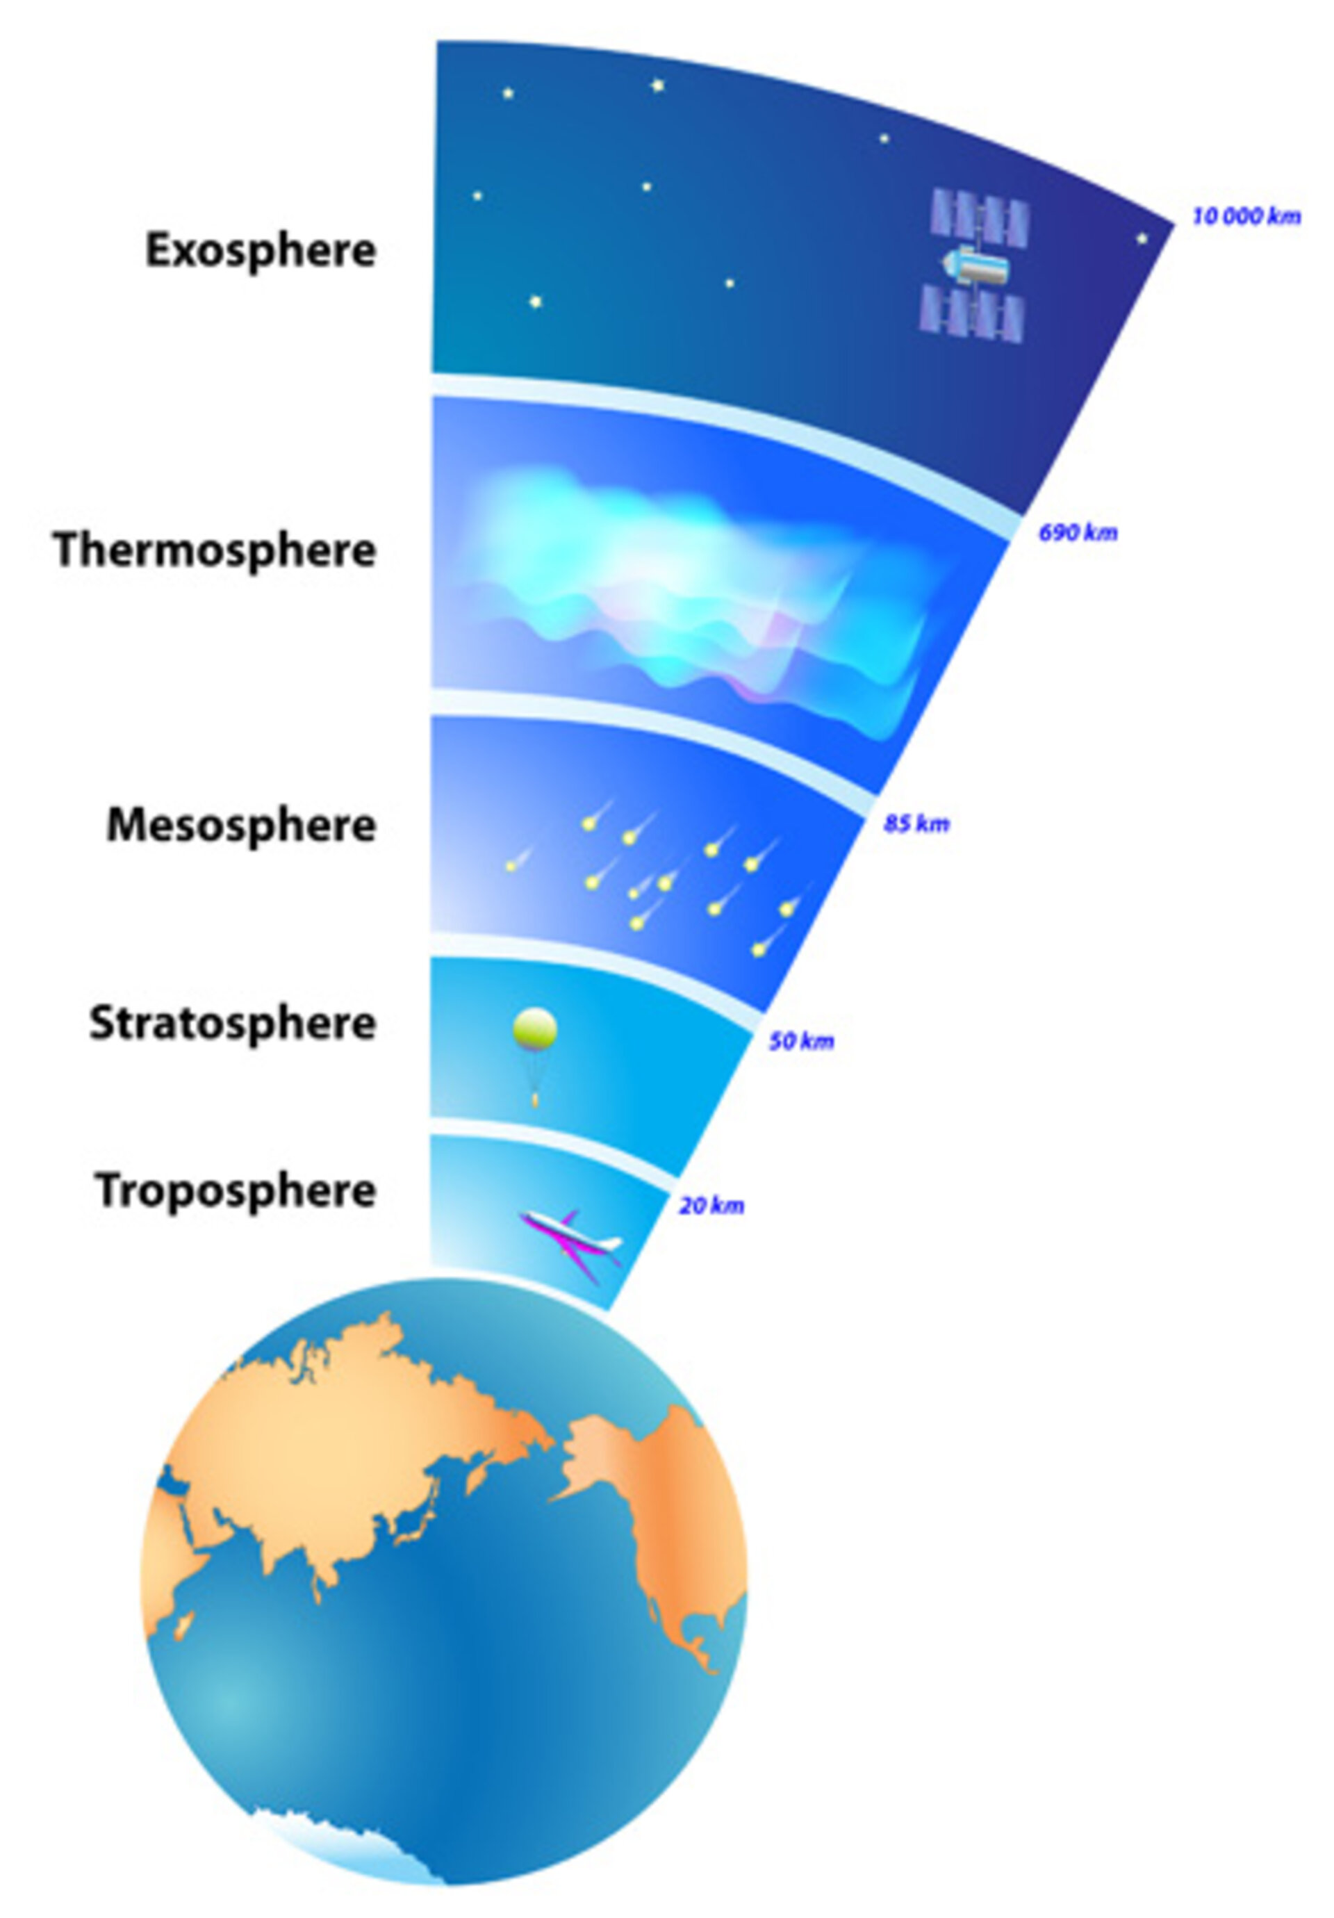
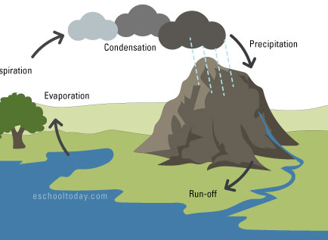
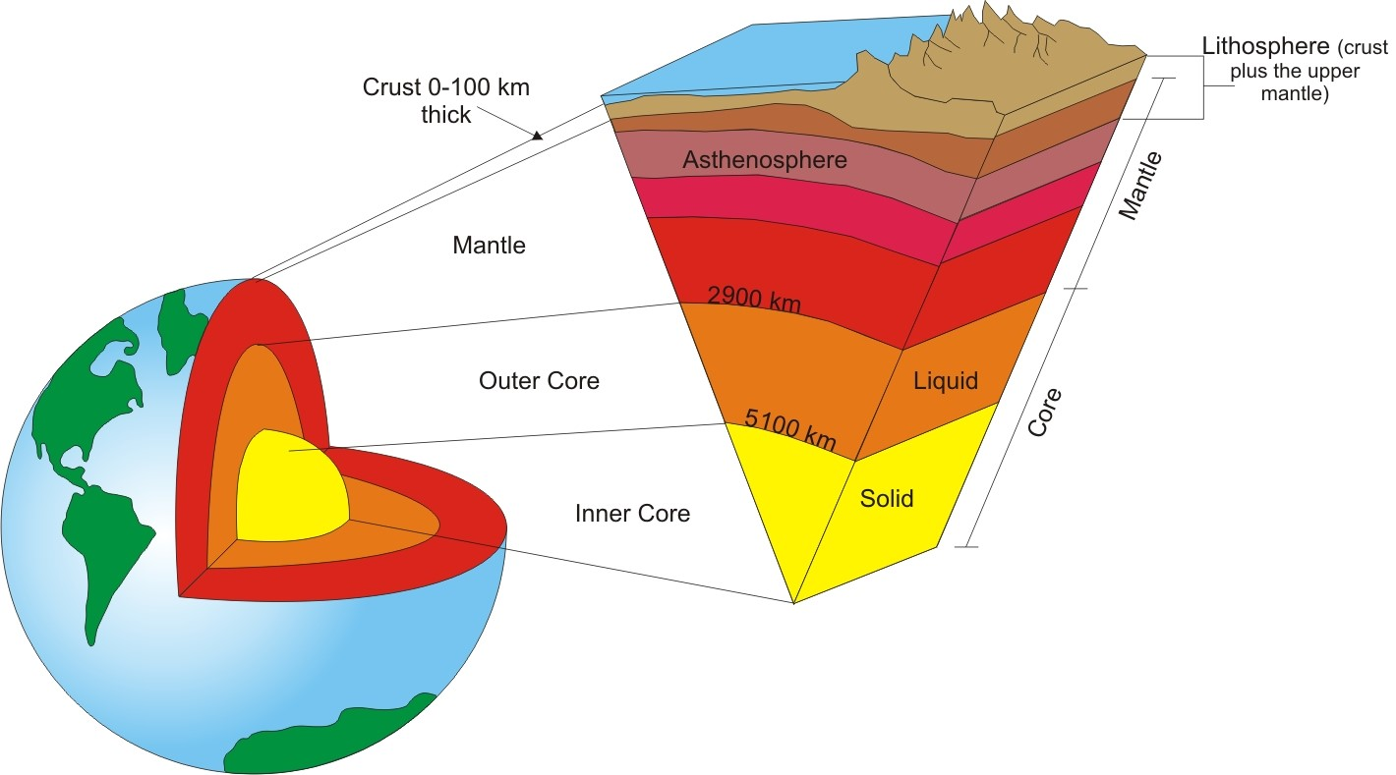

Slide 17
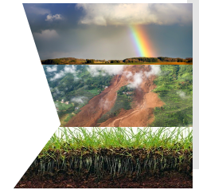
How do these spheres interact?
All 4 spheres are interconnected.
Their interactions create the abiotic and biotic aspects of our environment
Hydrosphere + Atmosphere = Weather
Hydrosphere + geosphere = landslides
Geosphere + biosphere = soil formation
Can you think of any other interactions?

Slide 18
Which spheres are involved and how are they interacting?

Slide 19
Which spheres are involved and how are they interacting?

Slide 20
Which spheres are involved and how are they interacting?

Slide 21
Which spheres are involved and how are they interacting?

