Slide 1
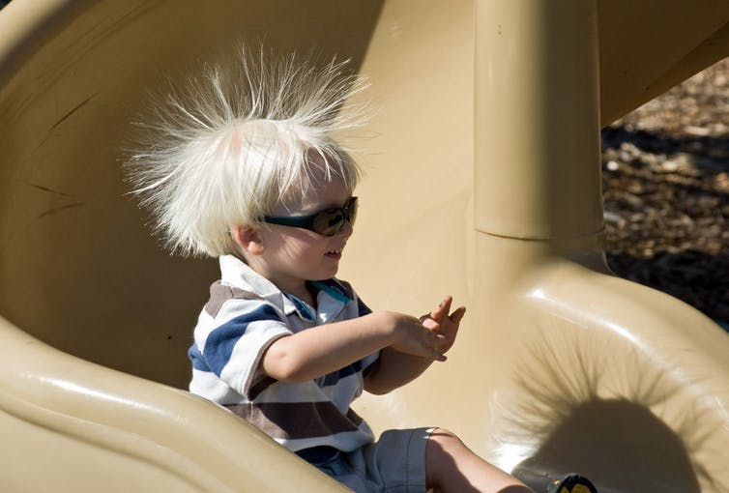
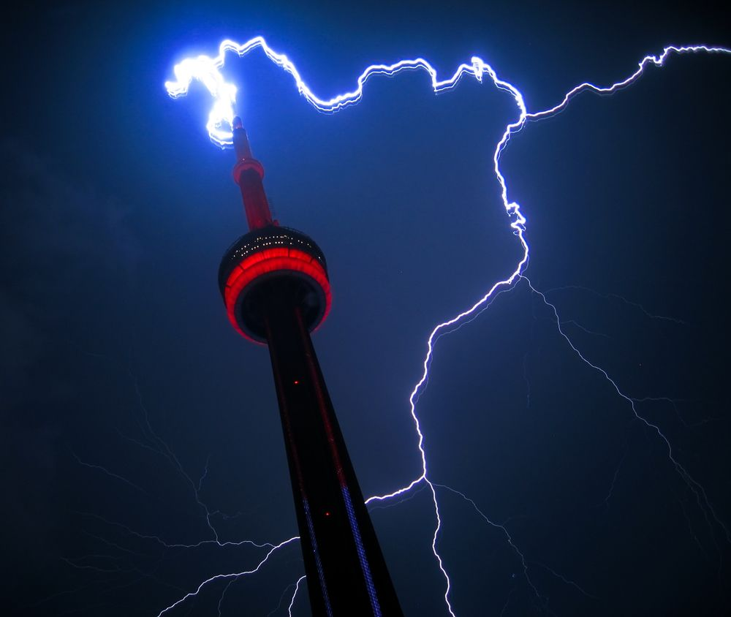
Physics II
Static Electricity
The Law of Electric Charge

Slide 2
If you were caught in a lightening storm, which of the following uniforms would keep you safe?
A wetsuit
A superman costume
A medieval coat of armour
A birthday suit

Slide 3
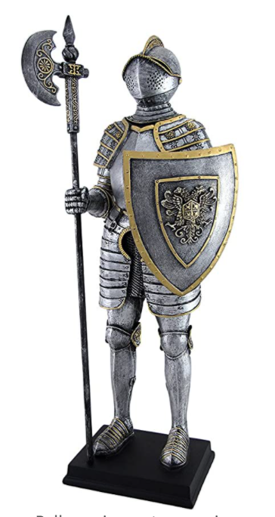
If you were caught in a lightening storm, which of the following uniforms would keep you safe?
A wetsuit
A superman costume
A medieval coat of armour
A birthday suit
https://www.youtube.com/watch?v=eNxDgd3D_bU&ab_channel=MinuteEarth

Slide 4
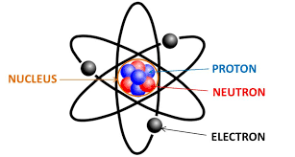
Review…
Electrons
Carry a negative charge
Surround the nucleus on energy shells and can be transferred from one atom to another
Protons
Carry a positive charge
Located within the nucleus and are held firmly in place

Slide 5
Static Electricity
Static electricity is a result of the imbalance between negative and positive charges within or on the surface of an object.
These charges can build up on the surface of an object until they find a way to be released or discharged.
A sudden flow of electrons from one charged object to another is called static discharge. This can result in a spark or shock (i.e., when you touch a metal doorknob after walking on a carpet in socks).

Slide 6
Static Electricity
It is possible to generate static electricity through friction. This will result in electrons being transferred from one material to another material.
When electrons are rubbed off a material, it becomes positively charged
The other material gains electrons and becomes negatively charged

Slide 7
Video:
https://www.youtube.com/watch?v=yc2-363MIQs&ab_channel=TED-Ed

Slide 8
Static Electricity
Notes:
Video:
https://www.youtube.com/watch?v=EM_sN_YHNow&ab_channel=FuseSchool-GlobalEducation

Slide 9
Practice questions
Explain the relationship among negative charges, positive charges, electrons, and protons.
Everything is made up of atoms. Within the atom are protons and electrons
Protons carry a positive charge
Electrons carry a negative charge
2. What action causes electrons to be moved from one material to another?
- Friction!

Slide 10
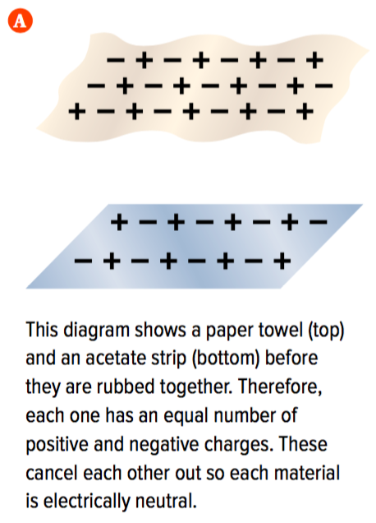
Charged vs Uncharged Materials
Uncharged materials:
These materials have equal numbers of positively charged protons and negatively charged electrons
This is described as being electrically neutral (the positive and negative charges cancel each other out)

Slide 11
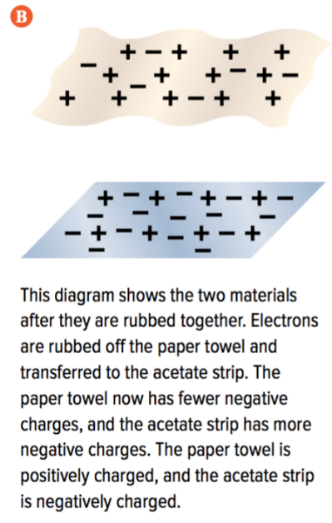
Charged vs Uncharged Materials
Charged materials:
Materials become charged due to friction
The electrons will be rubbed off of one material and transferred to the other material. The protons will stay behind.
These two materials will be considered electrically charged.
Electrically charged materials will have an unequal number of positive and negative charges.

Slide 12
Law of Electric Charge
The Law of Electric Charge states that:
Opposite charges attract each other
Like charges repel each other
Charged objects will also attract neutral objects

Slide 13
Law of Electric Charge
Demo:
https://phet.colorado.edu/en/simulation/balloons-and-static-electricity

Slide 14
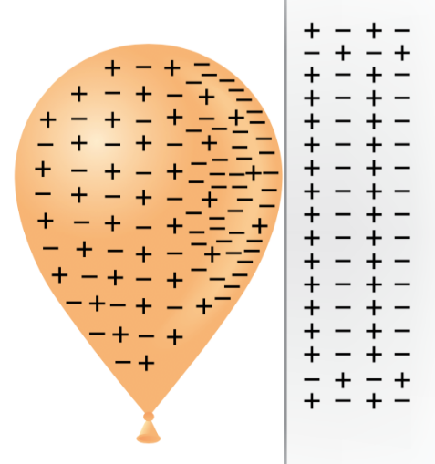
Why does a charged balloon stick to a wall?
When a charged object (a balloon) is brought near a neutral object (the wall), the electrons in the neutral object do not come off as there is no friction being applied
The negative charges in the wall are pushed away from the surface by the negative charges on the balloon (they want to repel each other)
Positive charges in the wall (they cannot move) are attracted to the negative charges on the balloon
This attraction is strong enough to hold the balloon to the wall

Slide 15
Static electricity lab
You will be going to 4 different stations – follow the instructions at each station
When charging you material, take note of its tendency to lose/gain electrons by using the triboelectric series chart

Slide 16
Exit slip
After rubbing the balloon against hair, are the hair and rubber balloon charged or uncharged? What happens when you hold them against each other?
Draw (with positive and negative charges) what happens when you charge a balloon with human hair

