Slide 1
What parts of the atmosphere do we lose everyday because of the sun?
1. Hydrogen
2. Oxygen
3. Nitrogen
4. Ozone

Slide 2
What parts of the atmosphere do we lose everyday because of the sun?
1. Hydrogen
2. Oxygen
3. Nitrogen
4. Ozone
https://www.youtube.com/watch?v=e7ZqMTBwFVs&ab_channel=MinuteEarth

Slide 3
Earth Science II
Solar Energy
Winds
Ocean Currents

Slide 4
Solar Energy
Solar energy comes from the Sun.
The solar energy that reaches Earth can either be absorbed and/or reflected by Earth’s atmosphere and its surface.

Slide 5
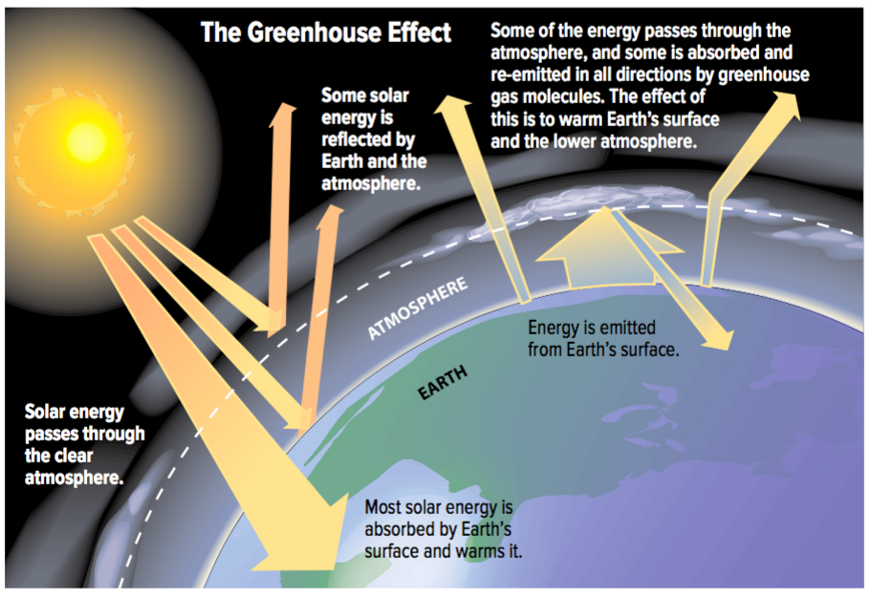

Slide 6
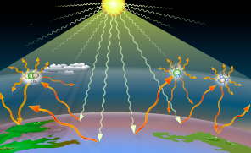
Solar Energy
Within Earth’s atmosphere, there are a number of greenhouse gases that help to trap heat and keep the Earth’s surface warm.
Greenhouse gases absorb solar energy in Earth’s atmosphere. Greenhouse gases can occur both naturally and through human activities.

Slide 7
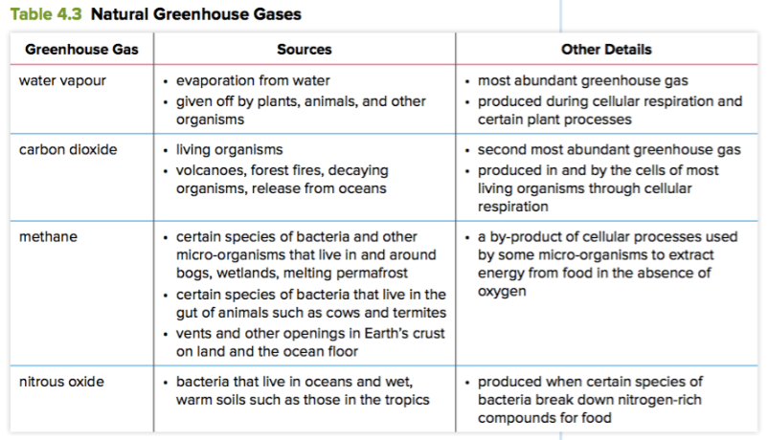
Greenhouse Gases from Human Activities | Sources
Carbon dioxide | Released from burning fossil fuels (coal, natural gas, oil)
Nitrous oxide | Enters the atmosphere when fertilizers are applied to crops
Methane | Released in large amounts by herds of cattle

Slide 8
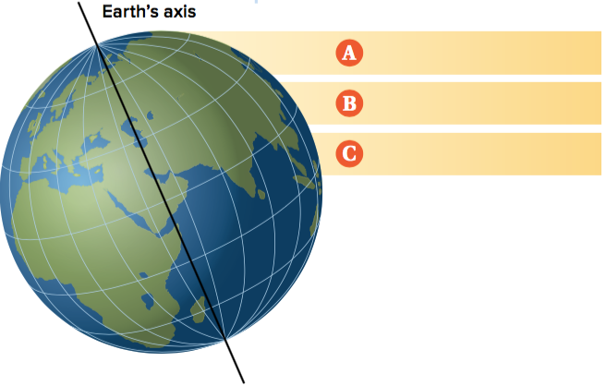
Winds
Winds occur when the surface of the Earth is heated unevenly.
The reason why Earth’s surface is heated unevenly is because of Earth’s spherical shape.
The Earth is closer to the Sun at the equator which will result in more solar energy reaching that part of the Earth; this will cause areas at the equator to be warmer.
Less direct sunlight is able to reach the north and south poles of the Earth; this will cause areas at the poles to be colder.

Slide 9
Winds
Warm air (less dense) near the Earth’s surface rises and eventually cool downs while cool air is denser and sinks.
This movement of the air is what causes winds to form. This phenomenon is called convection currents.

Slide 10
Winds
Along with the rising and sinking of the air, the Coriolis effect plays a part in how wind is distributed around the Earth.
The Coriolis effect occurs due to Earth’s rotation; Earth tends to rotate faster at the equator than at the poles.
The Coriolis effect makes things (like planes or air) travelling around the Earth appear to move in a curved fashion.

Slide 11
Video
https://www.youtube.com/watch?v=HIyBpi7B-dE&ab_channel=AtlasPro

Slide 12
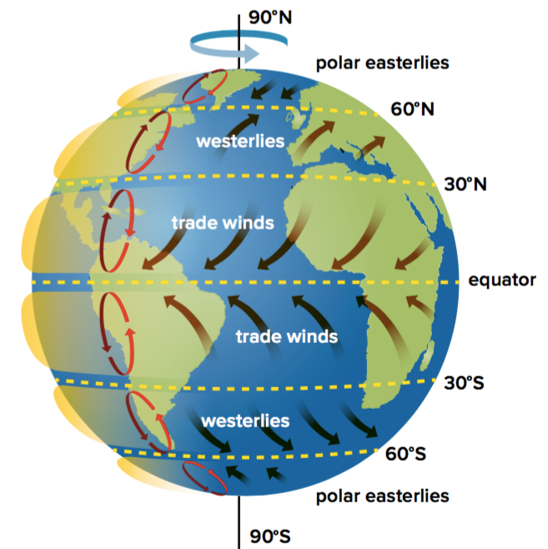
Winds
There are three major types of winds that the Earth has:
Trade winds:
Move east to west
Air near the equator warms, rises, and travels north or south
At the north or south, the air cools, sinks, and moves west

Slide 13
Winds
There are three major types of winds that the Earth has:
Westerlies:
Move from west to east
Steady winds that move much of the weather across North America

Slide 14
Winds
There are three major types of winds that the Earth has:
Polar easterlies:
Travel from east to west
Move cold air from polar regions back toward equator

Slide 15
Video
https://www.youtube.com/watch?v=NQ3Tj-tdQIk&ab_channel=MooMooMathandScience

Slide 16
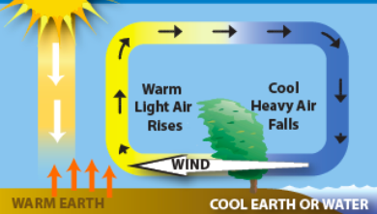
Practice Questions
1. Predict what would happen to Earth’s four spheres if the concentration of greenhouse gases in the atmosphere increased
Atmosphere – increase in greenhouse gases (H2O, CO2, CH₄, N₂O)
Biosphere – extreme weather events lead to animal and human fatalities
Hydrosphere – ice caps melt; increase in sea level
Geosphere – less land above sea water
2. Create an illustration to explain how the warming and cooling of air generates wind

Slide 17
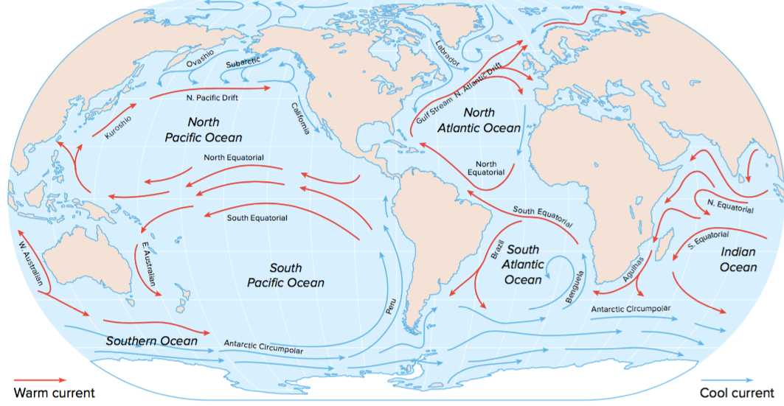
Ocean Currents
Ocean currents are also able to move thermal energy around the Earth. There are two major types of ocean currents:
Surface currents
These are created by the movement of the wind
Warm currents move heat from the equator to the poles while cold currents move cold water from the poles to the equator

Slide 18
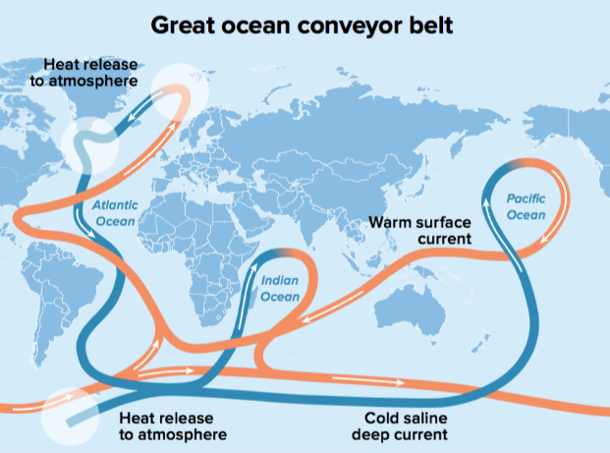
Ocean Currents
Great Ocean Conveyer Belt
A system of deep water currents that move deep water, heat, and nutrients around the Earth
Movement of this water is based on the temperature of the water and the salt content
Cold water is denser than warm water so it will sink; warm water is less dense than cold water so it will rise
Saltier water is denser so it will sink and move the less salty water up

Slide 19
Video
https://www.youtube.com/watch?v=p4pWafuvdrY&ab_channel=TED-Ed

