Slide 1
Apart from the South Pole (Antarctica), where else are penguins found?
1. The North Pole
2. Greenland
3. The Galapagos Islands
4. Iceland

Slide 2
Apart from the South Pole (Antarctica), where else are penguins found?
1. The North Pole
2. Greenland
3. The Galapagos Islands
4. Iceland
https://www.youtube.com/watch?v=EEcHbIWogxA

Slide 3
Earth Science III
Types of Organisms
Food chains, webs, and pyramids

Slide 4
Types of Organisms
An organism is a living thing.
Includes: Plants, animals, micro-organisms, fungi, insects
An organism:
Obtains energy from the environment
Contributes energy to the environment

Slide 5
Types of Organisms
There are three large categories that we can classify organisms. They are:
Producers
Living things that can make their own food to get the energy they need. Plants tend to be called ‘producers’ because they produce carbohydrates from carbon dioxide, water and the sun’s energy in a process called photosynthesis.
Example: Flowers, trees

Slide 6
Types of Organisms
Consumers
Living things that eat producers or other consumers to get the energy they need. Many animals and insects are consumers.
Example: fish, deer, wolves, spiders
There are three classification of consumers:
Herbivores: those that only eat plants
Carnivores: those that only eat other consumers
Omnivores: those that eat both plants and other consumers

Slide 7
Types of Organisms
Decomposers/Detrivores
Living things that break down waste and decomposing organisms to get the energy they need. We can also classify them as a type of consumer. Detrivores feed at every trophic level. Detrivores have their own, separate food chains, and are very numerous
Example: bacteria, fungi, earthworm

Slide 8
Which is it: Herbivore, Carnivore, or Omnivore?
Omnivore
Omnivore
Omnivore
Carnivore
Omnivore
Carnivore
Carnivore
Herbivore
Carnivore
Herbivore
Herbivore
Carnivore
Herbivore
Herbivore

Slide 9
Video
https://www.youtube.com/watch?v=0ZOvqYypOuo

Slide 10
Which of the following is NOT an apex predator?
1. Sea eagles
2. Tigers
3. Coyotes
4. Orcas

Slide 11
Which of the following is NOT an apex predator?
1. Sea eagles
2. Tigers
3. Coyotes
4. Orcas
https://www.youtube.com/watch?v=jsJj9q5UKlE

Slide 12
Food Chains, Webs, and Pyramids
There are a variety of ways that we can model how energy flows throughout an ecosystem.
What is a food chain?
Food chains show the flow of energy from one living thing to another.
Each step on the food chain is called a trophic level.
Every food chain starts with a primary source of energy. The most obvious source of energy is the sun.

Slide 13
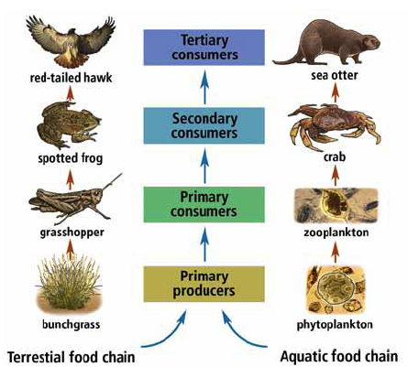
Food Chains
Examples of terrestrial and aquatic food chains
Primary Producers (1st trophic level) are organisms that can create their own food from the main energy source
Primary consumers (2nd trophic level) will eat the producers
Secondary consumers (3rd trophic level) will eat the primary consumers
Tertiary consumers (4th trophic level) will eat the secondary consumers
Apex consumers are consumers at the very top of the food chain.

Slide 14
Food Chains

Slide 15
Food Chains
In general, only about 10% of food energy is transferred from one organism to another (i.e., about 90% of food energy is lost).
Most of the energy transferred from one trophic level to another is lost to the environment as unusable heat, used to support life functions (growth, cellular respiration), and stored in wastes.
This means that less and less energy is available to each organism in the food chain.

Slide 16
What similarities/differences do you notice?

Slide 17
What is a Food Web?
Most organisms are part of a number of food chains. We can use a food web in order to model the relationships between organisms within an environment.
A change in the number of one organism could affect several food chains in the food web
All organisms in an ecosystem are connected and depend on each other for survival
In food webs, arrows point from an organism that is eaten to the organism that eats it. These arrows represent the direction that energy flows.

Slide 18
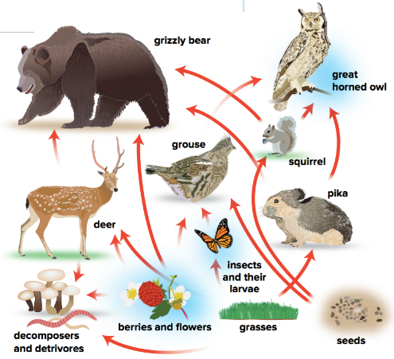

Slide 19
Video
https://www.youtube.com/watch?v=MGODmyXkkPU

Slide 20
What is an Energy Pyramid?
An energy pyramid is a model that shows the amount of energy available at each level of the food chain.
A level of the energy pyramid is called a trophic level.
Each trophic level represents the energy for those organisms.
Each time energy is transferred some of it is lost as unusable heat. The energy that is lost cannot be used by other living things. Therefore, a constant supply of energy is needed to sustain living things in terrestrial and aquatic ecosystems.

Slide 21
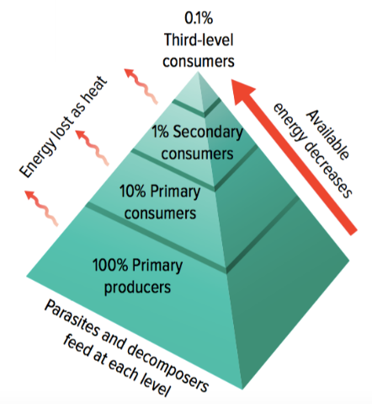
What is an Energy Pyramid?

