Slide 1
What percentage of rain actually reaches the ground?
1. 10-20%
2. 45-55%
3. 65-75%
4. 80-90%

Slide 2
What percentage of rain actually reaches the ground?
1. 10-20%
2. 45-55%
3. 65-75%
4. 80-90%
https://www.youtube.com/watch?v=1xQ0Ypp3r_8&ab_channel=MinuteEarth

Slide 3
Earth Science IV
Water Cycle
Carbon Cycle

Slide 4
Matter Cycles
Matter cycling occurs when matter moves from one place to another on Earth.
Matter can cycle throughout the Earth both naturally and through human activities.
In this unit, we will be discussing four major matter cycles: water, carbon, nitrogen, and phosphorus.

Slide 5
Water Cycle
Water is everywhere on Earth’s surface in the form of ponds, lakes, rivers, oceans, snow, and ice.
It can also be found under Earth’s surface in the form of ground water and in the air as water vapour.

Slide 6
Water Cycle
All water continuously cycles through ecosystems through three main processes:
Evaporation: Heat from the Sun causes water at Earth’s surface to evaporate changing liquid water into water vapour
Condensation: As warm air rises, it cools and condenses into water droplets or ice crystals, forming clouds
Precipitation: Water falls back to Earth’s surface when it rains, snows, sleets, or hails

Slide 7
Water Cycle
Water is able to travel along Earth’s surface as ‘run-off’; it will move downhill back into the ocean due to gravity.
Water that is underground is called ground water.
Water moves from the ground surface into the soil by a process called infiltration

Slide 8
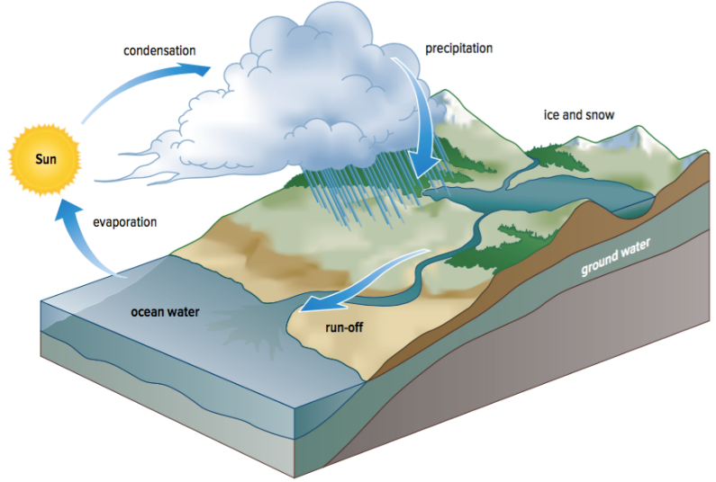
Water Cycle
Notes:
Add: infiltration

Slide 9
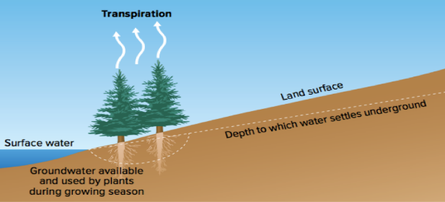
Water Cycle
Water can also travel through the biosphere by a process called transpiration.
Transpiration occurs when water is absorbed by the roots of a plant, carried through it, and eventually it will evaporate through small pores in the leaves.
Figure 4.17: Studies show that about 10% of water vapour in the atmosphere is released by plants.

Slide 10
How have humans impacted the water cycle?
Water can be polluted when the water quality of both fresh and salt water have been changed.
This can result in negative effects on organisms and can make water unsuitable for its desired uses.

Slide 11
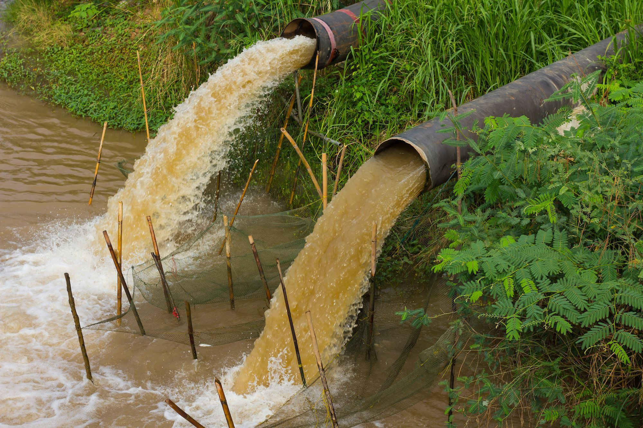
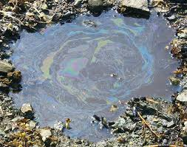
Types of Pollution
There are two major types of pollution:
Point source pollution: a single identifiable source of pollution that pollutants come from
Examples: factories, power plants, sewage treatment plants, oil wells
Non-point source pollution: a source of pollution that is difficult to track where it comes from; these pollutants are released in a wide area
Examples: run-off from farms, construction sites, parking lots

Slide 12
Effects of Pollution
When pollutants enter into the environment, it is difficult for it to break down.
When micro-organisms (phytoplankton, bacteria) eat pollutants in the water (such as pesticides, plastics, etc.), it will collect in its cells and body tissues.
This can lead to bioaccumulation and biomagnification.

Slide 13
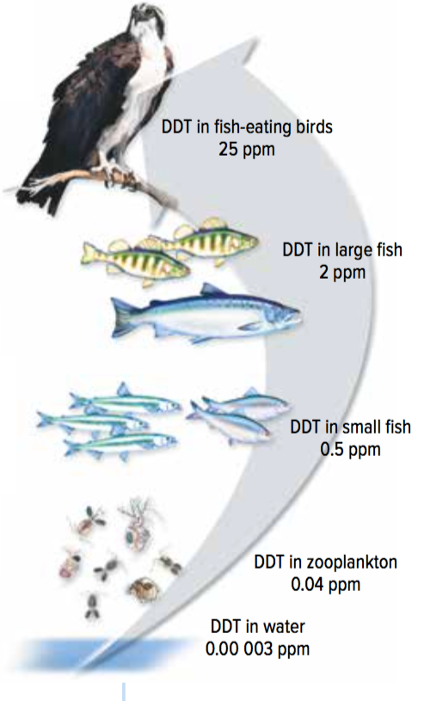
Effects of Pollution
Bioaccumulation: the process where pollutants collect in the cells and tissues of organisms
Biomagnification: the increase in concentration of pollutants in tissues of organisms that are at higher levels in a food chain or food web

Slide 14
Practice Questions
Explain why the sun and gravity are considered the driving forces of the water cycle
The sun is the driving force behind evaporation, and gravity is the driving force behind precipitation and run-off. Both are necessary for the water cycle to continue
2. Would biomagnification be possible without bioaccumulation occurring? Explain
Bioaccumulation is necessary for biomagnification to happen; pollutants need to first be collected in the tissues of organisms before they can increase in concentration as they go up the food chain

Slide 15
If we planted 1 trillion more trees, what fraction of humanity’s carbon emissions would be drawn down?
1. 1/8
2. 1/6
3. 1/4
4. 1/2

Slide 16
If we planted 1 trillion more trees, what fraction of humanity’s carbon emissions would be drawn down?
1. 1/8
2. 1/6
3. 1/4
4. 1/2
https://www.youtube.com/watch?v=3hxE7Af98AI&ab_channel=TED-Ed

Slide 17
Carbon Cycle
Carbon is cycles through both abiotic and biotic factors. In the carbon cycle, carbon predominantly exists in the form of carbon dioxide gas (CO₂).
Carbon dioxide gas moves from the atmosphere into the biosphere through photosynthesis and cellular respiration
Carbon dioxide also moves back to the atmosphere when organisms die and decompose
Carbon enters the geosphere when the remains of organisms are trapped under sediment layers

Slide 18
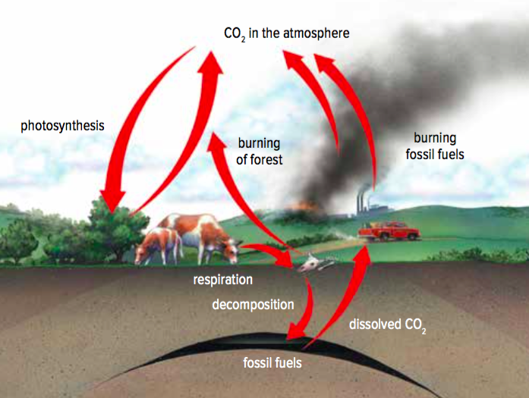
Carbon Cycle
Figure 4.20: During the carbon cycle, carbon is exchanged among the biosphere, atmosphere, and geosphere.

Slide 19
Video
https://www.youtube.com/watch?v=Xz0fn81BlIQ

Slide 20
Carbon Cycle
Carbon can also be stored in order to be used for later.
Some carbon is stored in the woody tissue of living trees
Some carbon is stored in the decomposing remains of organisms buried deep in the ground
Over time, this stored carbon transforms into carbon-rich fossil fuels (coal, oil, natural gas)

Slide 21
Video
https://www.youtube.com/watch?v=4vJ_1ojjlxw&ab_channel=MelissaLandeen

Slide 22
How have humans impacted the carbon cycle?
The amount of carbon dioxide used by photosynthesis and given off by cellular respiration is nearly the same (carbon dioxide is balanced).
Over time, human activities (such as burning fossil fuels, burning trees) have impacted the carbon cycle by releasing excess carbon into the atmosphere. This excess carbon has led to global warming and global climate change as carbon dioxide is a greenhouse gas that traps heat in the atmosphere.
Global warming: An increase in the average temperature of Earth’s surface
Global climate change: A long-term change in Earth’s climate

Slide 23
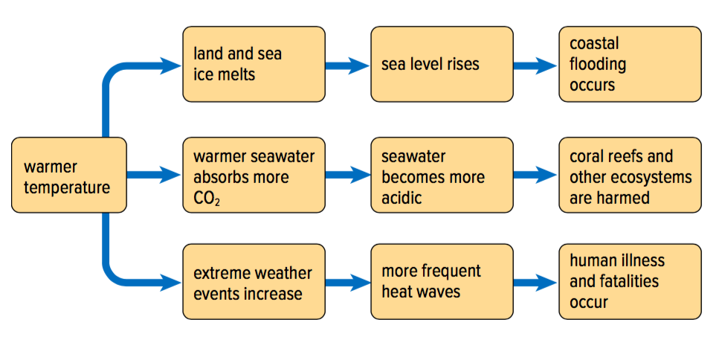
The Effects of Excess Carbon
Earth’s surface temperature: Increased by between 0.56°C and 0.92°C in the past 100 years
This “small” change can affect conditions in all of Earth’s spheres

Slide 24
The effects of rising sea level
Some islands have gone underwater
Salt water gets into the drinking water supply
Coastal flooding and destruction of wetlands

Slide 25
The effects of changing ocean chemistry:
Ocean becomes more acidic because it absorbs more carbon dioxide from the air
An acidic and warming ocean can destroy coral reefs and corals themselves (acidity dissolves the organisms’ shells)

Slide 26
The Amazing Nutrient Cycle Activity
Pretend you’re a carbon atom
You will start somewhere on/above/under Earth and proceed on a journey from there.
Rolling the dice will determine what happens to you.
Record what happens on your worksheet.
We will go to the superlab. Pick a place to start your adventure; only 3 students max at one station to start. Write the place you start at #1 on your sheet. Every time you move, write notes on your sheet about what has happened to you.
Does the journey ever end?

