Slide 1
Physics V
Series circuits
Parallel circuits

Slide 2
Which of the following generate the most electrical energy?
1. Coal
2. Nuclear
3. Windmills
4. Water turbines

Slide 3
Which of the following generate the most electrical energy?
1. Coal
2. Nuclear
3. Windmills
4. Gas
Because they all spin turbines!
https://www.youtube.com/watch?v=PMRiKmgxrh0

Slide 4
Circuits
There are many different ways in which components in a circuit can be connected together. The two main types of circuits we can build are a series and a parallel circuit.

Slide 5
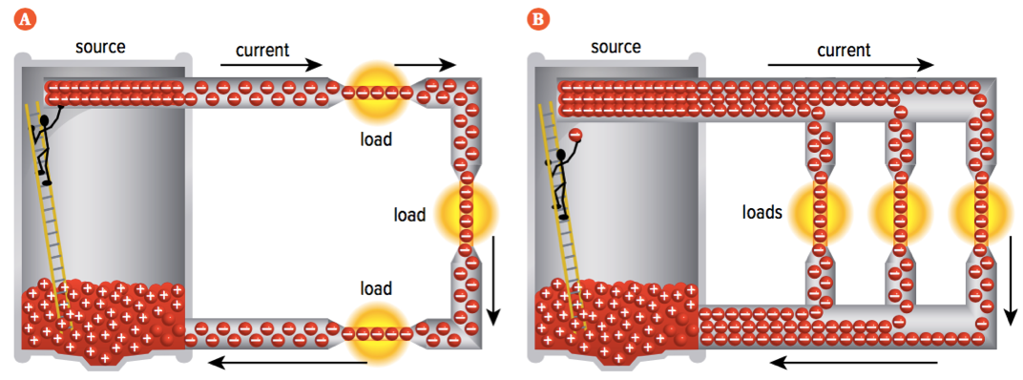
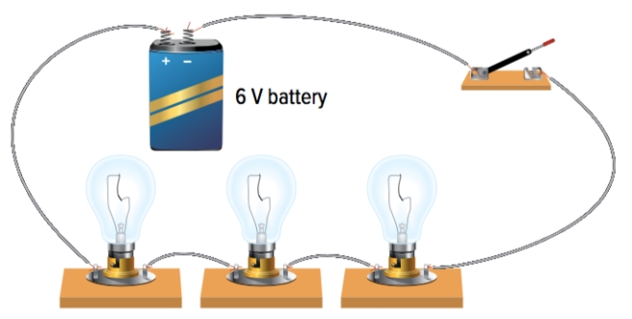
Series circuits
A series circuit is a circuit that allows the current to flow on only one pathway.
As there is only one path that current can flow, the current remains the same no matter where you measure on the circuit.

Slide 6
Series circuits
The voltage provided by the battery is shared between all of the loads that are connected in the circuit. This will result in less voltage going across each of the individual loads.
Example: Adding more lights into the circuit will result in less brightness across each of the bulbs because there is less voltage provided for each light.
If one part of the circuit is broken or incomplete, this will result in the entire circuit not working.

Slide 7
Parallel circuit
A parallel circuit is a circuit that contains multiple pathways for the current to flow.
The current splits into many parts which means that the current is reduced in each of the paths.
The total amount of current leaving and entering the battery will remain the same.

Slide 8
Parallel circuits
The voltage provided by the battery is not shared across all of the loads. This will mean, the amount of voltage going across each load will be the same.
Example: adding more lights into the circuit in parallel will not change the brightness of the bulbs because the amount of voltage does not change
If one part of the circuit is broken or incomplete, the circuit can still continue to work as there will be other closed pathways for the current to travel.

Slide 9
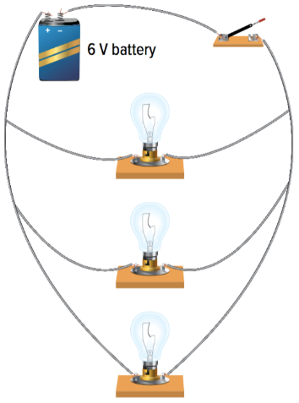
Parallel circuits
Parallel loads can be commonly found in homes and buildings as individual switches can be added to each load in order to control what load is on and/or off
In the above figure:
The battery and switch are connected in series
The light bulbs (loads) are connected in parallel

Slide 10
In Summary...
 | Series | Parallel
Definition | A circuit with ONE pathway for electrons to flow | A circuit with MULTIPLE PATHWAYS for electrons to flow
Voltage (volts) | ↑ source = ↑ voltage ↑ loads = ↓ voltage | Stays the same
Current (amps) | Stays the same | Reduced at each junction
Memory Aid | SASS “Series Amps Stay the Same” | PVSS “Parallel Voltage Stays the Same”

Slide 11
Note…
Voltmeters are always connected in parallel with respect to the object that it is measuring
Ammeters are always connected in series to the circuit

Slide 12
To do now
Drawing Circuit Diagrams for Series and Parallel Circuits Worksheet

