Slide 1
What has been both the best and the worst energy source so far?
1. Nuclear
2. Solar
3. Coal
4. Hydro

Slide 2
What has been both the best and the worst energy source so far?
1. Nuclear
2. Solar
3. Coal
4. Hydro
https://www.youtube.com/watch?v=edBJ1LkvdQQ

Slide 3
Physics V
Power
Sustainability
Generating Electrical Energy

Slide 4
Power
There are two main ways that we are able to measure electrical energy:
Watts and Kilowatts
Kilowatt-hours

Slide 5
Power
These two ways of measuring out electrical energy is related to the power output by the load. Electrical power is the rate that electrical energy is used by a load.
Electrical power is measured in watts (W) or kilowatts (kW)
1 kW = 1000 watts

Slide 6
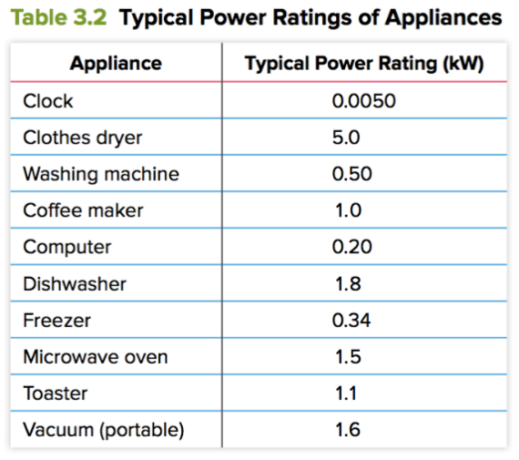
Power
Appliances all have a power rating (the rate that they use energy).
Example:
- Lightbulb: 100 W
- Iron: 1000 W
If we compare the power rating of a light bulb and an iron that is on for the same length of time, the iron will use 10 times more energy.

Slide 7
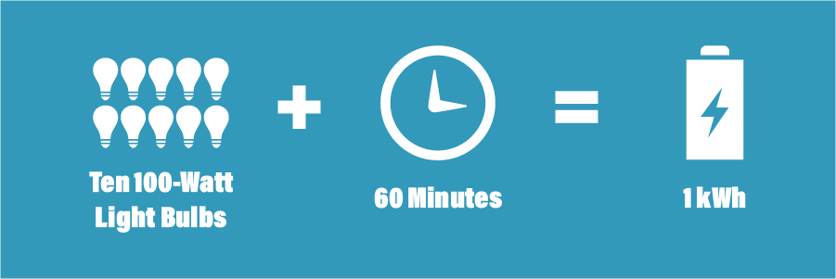
Kilowatt-hours

Slide 8
Kilowatt-Hours
Electrical energy used by an appliance over a period of time is measured in kilowatt-hours (kWh). We can find this quantity by first looking at the power rating of the appliance and by measuring the amount of time the load has been used.

Slide 9
Video
https://www.youtube.com/watch?v=zRYESRObKqA&ab_channel=EnphaseEnergy

Slide 10
Example:
If you used a 1.8 kW dishwasher for 2.0 hours, how many kilowatt-hours of electrical energy would you have used?
$$Power= kilowatt ×hours$$
$$Power=1.8 kW ×2.0 hours$$
$$Power=3.6 kWh$$

Slide 11
Example:
If a 1600 W vacuum has been turned on for 30 minutes, how many kilowatt-hours of electrical energy would have been used?
$$Power= kilowatt ×hours$$
$$1600 W × \frac{1 kW}{1000 W}=1.6 kW$$
$$Power=1.6 kW ×0.5 hours$$
$$30 minutes× \frac{1 hour}{60 minutes}=0.5 hours$$
$$Power=0.8 kWh$$

Slide 12
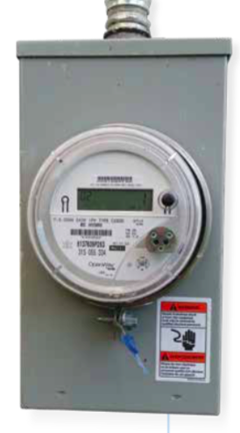
Smart Meters
In our homes and in buildings, we are able to measure the amount of electrical energy used by using a smart meter. A smart meter is able to measure how energy use changes in a building over the course of a day.

Slide 13
Sustainability
Many appliances that we buy are able to tell us how much energy it uses through two labels:
EnerGuide labels
ENERGY STAR ® label

Slide 14
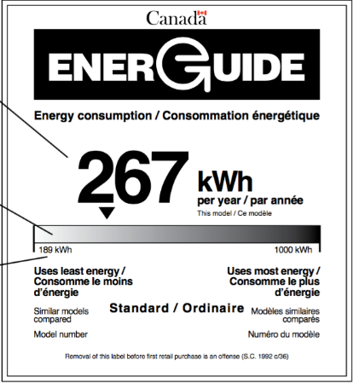
Energuide Label
This is a label that gives details about the amount of energy that an appliance uses during one year of normal use
Large number: Shows how much energy is used in one year of normal use
Shaded bar: Shows how the appliance compares with similar ones on the market
Numbers on the shaded bar: Gives a range of efficiency for yearly energy use

Slide 15
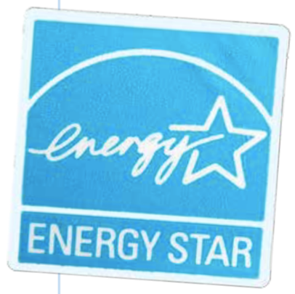
Energy Star ® Label
This is a label that is located on appliances. It tells us if a product is an energy efficient appliance. Appliances with this label use 10-50% less energy compared with a standard product in the same category.

Slide 16
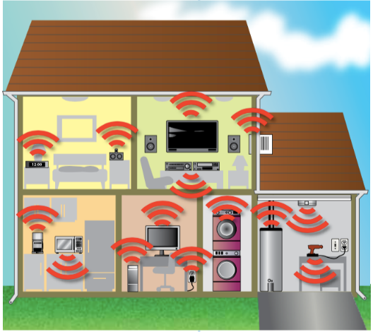
Phantom Loads
In our homes, we may have appliances that continue to use energy even if it is not on. This is called a phantom load.
A phantom load occurs when electrical energy is being used on a device when it is turned off
Appliances in stand-by mode (TVs, computers) are actually “on” and have phantom loads
Phantom loads account for about 900 kWh of energy use each year in the average home.
In order to save energy, unplug your devices when not in use!

Slide 17
Practice Questions
1. If a 2000 W dishwasher has been turned on for 45 minutes, how many kilowatt-hours of electrical energy would have been used?
Power = kilowatt x hours
Power = 2 kW x 0.75 hours = 1.5 kWh
2. Explain how electrical energy can be used by an electric toothbrush that is plugged in but is not running
The toothbrush is still drawing electrical energy out of the outlet that it’s plugged into even if it’s not turned on. This is called a phantom load

Slide 18
Generating Electrical Energy
In order to generate electrical energy, most stations will use a generator system. A generator system is composed of three main parts:
Turbine: steam, water, or wind will cause the turbine to spin
Shaft: The shaft connects the turbine to the generator; if the turbine spins, the shaft spins
Generator: Kinetic energy from the shaft is transformed into electrical energy in the generator

Slide 19
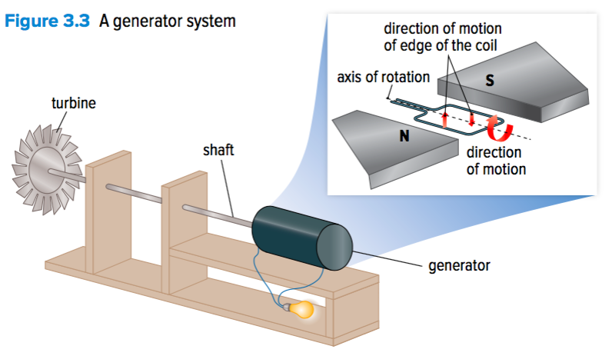

Slide 20
Generating Electrical Energy
In BC, much of our energy is supplied through hydroelectric energy.
Dam station: will use the kinetic energy from the water as it flows downhill to turn a turbine in order to generate electrical energy

Slide 21
Generating Electrical Energy
In BC, much of our energy is supplied through hydroelectric energy.
Run-of-river station: water flowing freely in a river turns a turbine

Slide 22
Other ways of generating electrical energy:
Wind turbines: kinetic energy of the wind is transformed into electrical energy as the wind moves the turbine of the generator system
Solar panels: Photovoltaic cells within the solar panel transform solar energy into electrical energy. The solar energy is absorbed by the electrons in the photovoltaic cells which allows them to flow.
Geothermal sources: Steam from the Earth’s crust can be used to turn turbines in the generator system.

Slide 23
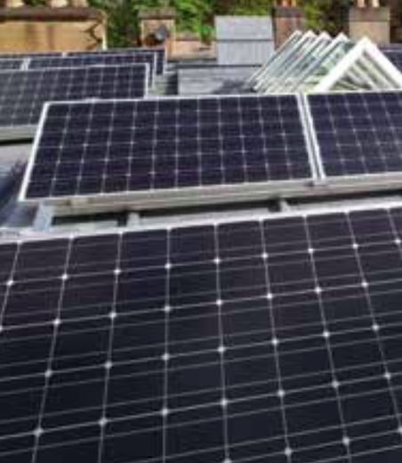
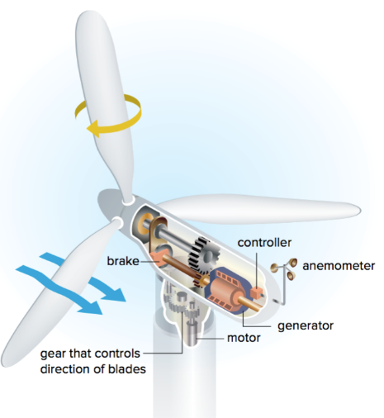
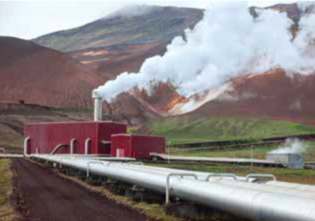

Slide 24
Video
https://www.youtube.com/watch?v=RnvCbquYeIM&ab_channel=TED-Ed

