Slide 1
Chemistry 12
Lab Safety

Slide 2
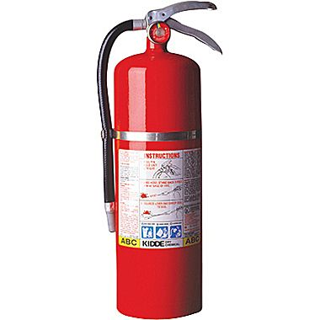
1. Emergency Equipment
Only to be used in an emergency
Do not need to ask permission before using, but must be able to justify why it was used
1.1 Fire Extinguisher
Pull fire alarm
Aim at base of fire, sweeping back and forth
Do not use on people
Turn gas valves off

Slide 3
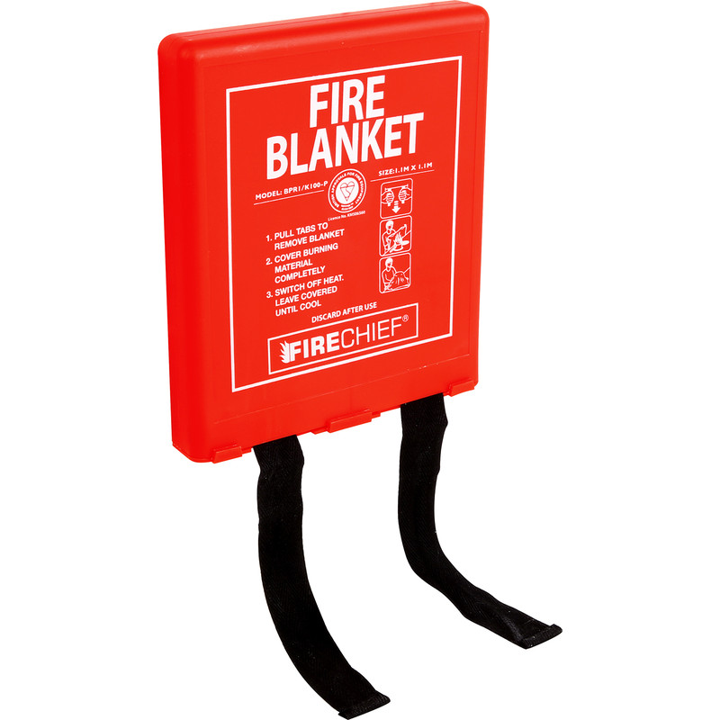
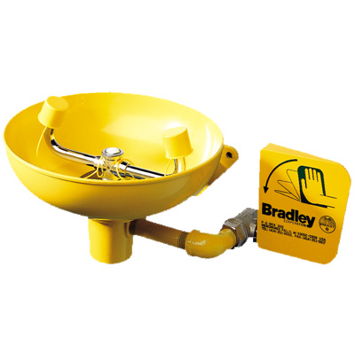
1. Emergency Equipment
1.2 Fire Blanket
Used when clothing/hair is on fire
Remember: stop, drop and roll
Turn gas valves off
1.3 Eyewash
Used anytime a chemical/solution gets into eyes
Push hand paddle downwards
Keep eyes open in water, blinking rapidly to help rinse under eyelid
Remove contact lenses
Seek medical attention

Slide 4
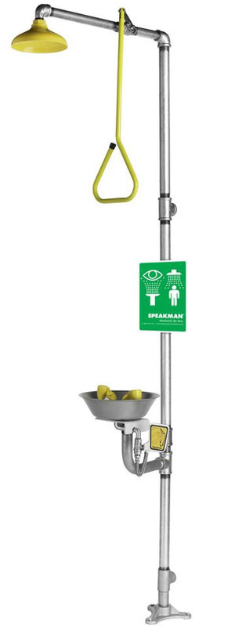
1. Emergency Equipment
1.4 Emergency Shower
Used for large chemical spills over body
Clothing soaked in chemicals must be removed
Be careful not to slip

Slide 5
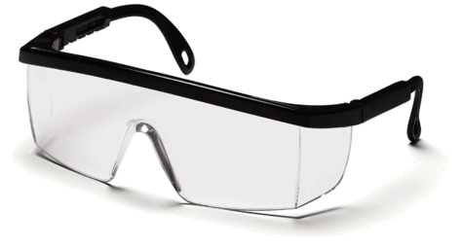
2. Protective Equipment
2.1 Safety Glasses
Must be worn during lab activities that involve heating and/or chemicals (from start to finish!)
Glasses with large frames may be worn as a substitute
2.2 Fume Hood
Use whenever poisonous odors are being produced

Slide 6
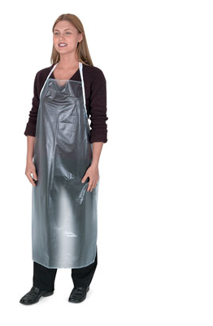
3. Personal Protection
3.1 Contact Lenses
Difficult to remove if chemicals get in eye
Soft lenses can absorb chemical vapors
Prevents natural eye fluids from removing contaminants
3.2 Clothing
Clothing is how you protect your skin from chemicals!
As much skin as possible should be covered (feet, legs, arms, etc.)
Sandals are not permitted (closed toe shoes only)

Slide 7
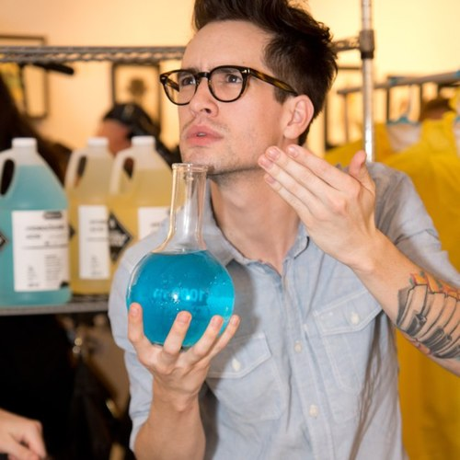
3. Personal Protection
3.3 Hair
Long hair must be tied back
Hats must be removed or worn backwards
3.4 Food/Drink
Never eat/drink/store food in the lab
Do not taste chemicals
To smell a chemical, gently waft the air towards yourself

Slide 8
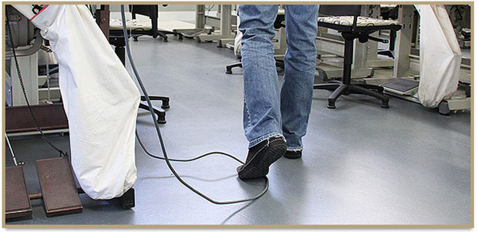
3. Personal Protection
3.5 Electronic Devices
Headphones/music are NEVER permitted in the lab
Do not let your electronic device distract you from your experiment!
3.6 Electric Cords
Unplug electric cords by pulling on the plug, not the cord
Do not leave cords dangling where other students may trip

Slide 9
3. Personal Protection
3.7 Heating
Do not leave a Bunsen burner or hot plate unattended
Never reach across a flame
When heating test tubes, point the open end away from yourself and others
Check glassware for cracks before heating
Move hot containers with clamps, tongs or oven mitts
Rest hot containers on a piece of wire mesh
If you burn yourself, immediately run your skin under cool water

Slide 10
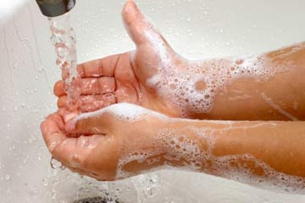
4. Behavior
4.1 Appropriate Behavior
No horseplay/running
Store personal belongings in cubicles or along side wall
Be prepared! Read all instructions before the lab begins
Do not carry hot equipment or dangerous chemicals through crowds of students
Wash hands with warm water and soap after each lab activity

Slide 11
5. Chemical Safety
Do not perform unauthorized experiments or handle equipment without permission
Keep all lids closed when a chemical is not being used
Notify teacher if chemicals are spilled
Dispose of chemicals as instructed by teacher. If a chemical can go down the sink, flush it with lots of water
Pour liquid chemicals carefully (preferably over the sink)
When diluting an acid, pour the acid into water

Slide 12
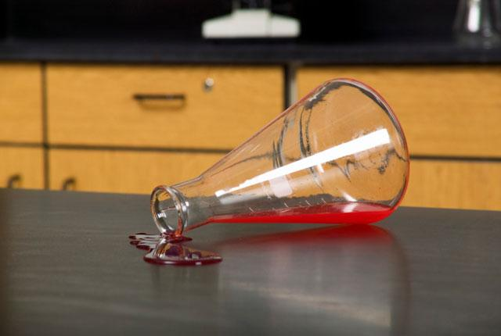
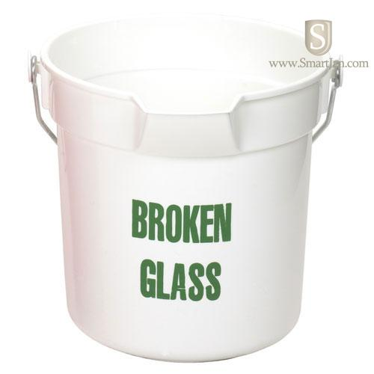
6. Just In Case…
6.1 Spills
Notify teacher
Low hazard spills should be cleaned up with paper towel/water
Shut off gas immediately if spill is flammable
If chemical contacts skin/eyes, flush affected area for 15 minutes
6.2 Broken Glass
Notify teacher
Sweep into broken glass container

Slide 13
7. Questions?

Slide 14
Lab Equipment
Chemistry 12

Slide 15
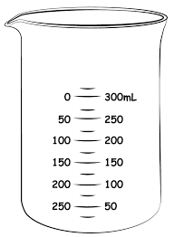
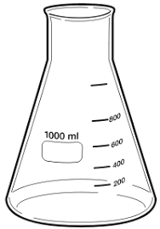
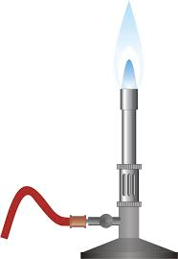
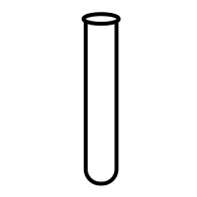
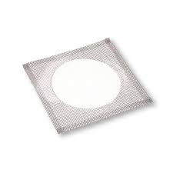
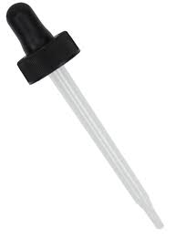
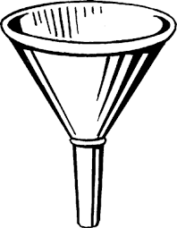
Name the following pieces of equipment. If you do not know the name, describe how it would be used.
1. 2. 3. 4.
5. 6. 7. 8.
beaker
test tube
Erlenmeyer flask
Bunsen burner
eyedropper
graduated cylinder
funnel
wire gauze

Slide 16
Activity
You will now do safety stations and an equipment scavenger in the lab!

