Slide 1
Electrochemistry I-II
Whiteboard Practice

Slide 2
Oxidation Numbers
ZnSO₃
H₂SO₄
Al(OH)₃
K₂CrO₄
Zn = +2 S = +4 O = -2
H = +1 S = +6 O = -2
Al = +3 H = +1 O = -2
K = +1 Cr = +6 O = -2

Slide 3
Balance this redox reaction:
SeO₃²⁻ + I⁻ → Se + I₂
6 H⁺ + SeO₃²⁻ + 4 I⁻ → Se + 2 I₂ + 3 H₂O
Which species is your reducing agent?
I⁻

Slide 4
Balance this redox reaction:
C₂H₄ + P₄ → CO₂ + PH₄⁺
4 H₂O + 4 H⁺ + C₂H₄ + P₄ → 2 CO₂ + 4 PH₄⁺
Which species is your oxidizing agent?
P₄

Slide 5
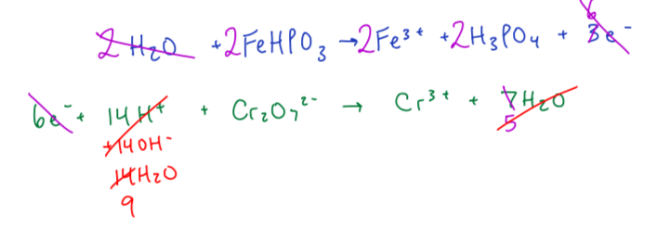
Balance this redox reaction:
FeHPO₃ + Cr₂O₇²⁻ → Cr³⁺ + H₃PO₄ + Fe³⁺ (basic)
9 H₂O + 2 FeHPO₃ + Cr₂O₇²⁻ → 2 Cr³⁺ + 2 H₃PO₄ + 2 Fe ³⁺ + 14 OH⁻

