Slide 1
Reaction Kinetics
Final Exam Review

Slide 2
Consider the reaction:
Ca_{(s)} + 2HBr _{(aq)} → H_{2 (g)} + CaBr_{2 (aq)} + heat
a. List 3 ways you could MEASURE the rate of reaction:
b. List 3 ways you could INCREASE the rate of reaction:
Weigh mass of Ca_{(s)} – will decrease as reaction progresses
Measure pressure of H_{2 (g)} – will increase as reaction progresses
Measure temperature – will increase as reaction progresses
Increase surface area of Ca_{(s)} by grinding it to a powder
Increase concentration of HBr_{(aq)}
Add a catalyst

Slide 3
State whether the following are endothermic or exothermic
CH₄ + 2 O₂ → CO₂ + 2 H₂O + 889 kJ
C + D → CD ΔH= 65.8 kJ
Fe₂O₃ + 2 Al → Al₂O₃ + 2 Fe ΔH= -852 kJ
E + F + 437 kJ → G + H
exothermic
endothermic
exothermic
endothermic

Slide 4
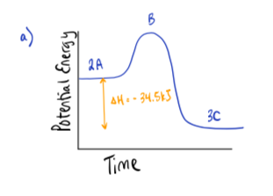
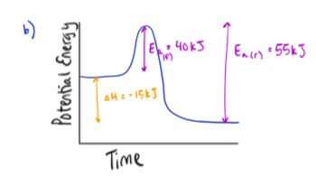
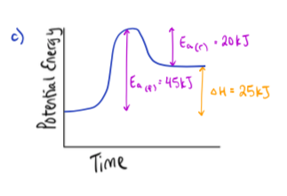
a) When two moles of A react with one mole of B, a reaction occurs in which three moles of C are formed and 34.5 kJ of heat are given off. Write an equation for this reaction showing the heat of reaction (∆H) at the right of the equation. Sketch a PE diagram
b) Consider a reaction where the change in enthalpy is -15kJ, and the activation energy for the forward reaction is 40kJ. What is the value of the activation energy for the reverse reaction? Sketch a PE diagram
c) Draw and label a PE diagram to show the enthalpy change and activation energies for a reaction in which: E_{a(f)} = 45 kJ and E_{a(r)} = 20 kJ
2 A + B → 3 C + 34.5 kJ ∆H= -34.5 kJ
E_{a(r)} = 55 kJ

Slide 5
Given the reaction mechanisms:
Step 1: HCOOH + H⁺ → HCOOH²⁺ (fast)
Step 2: HCOOH²⁺ → H₂O + HCO⁺ (slow)
Step 3: HCO⁺ → CO + H⁺ (fast)
a) Identify the two intermediates
b) Identify the catalyst in this mechanism
c) Another catalyst is discovered which increases the rate of only Step 1. How will this affect the rate of the overall reaction? Explain your answer.
d) Which step has the greatest activation energy?
e) How many "bumps" will the potential energy diagram for the reaction have?
f) Which step would be considered rate determining step in this mechanism?
g) In order to have successful collisions, the colliding particles must have both the proper amount of energy and the proper _____________________.
HCOOH²⁺, HCO⁺
H⁺
No impact – have to speed up RDS
Step 2
3
Step 2
geometry

Slide 6
Chemical Equilibrium
Final Exam Review

Slide 7
CaCO_{3(s)} → CaO_{(s)} + CO_{2(g)} ΔH = 110 kJ
For a) to d) below will the equilibrium shift left or right or not change if…
a) container volume is increased?
b) some CaCO_{3(s)} is removed?
c) temperature is increased?
d) CO_{2(g)} is added?
Shift right
No shift
Shift right
Shift left

Slide 8
Equation: | Temperature change: | K_{eq} result: | Exo or Endo:
H + G ⇋ Y ΔH= - 100 kJ/mol | Increase
Q + R ⇋ M | Decrease |  | Endo
W + X ⇋ Y + Z + 100 kJ | Decrease
A + B ⇋ C + D | Increase | Increase
C + F ⇋ U |  | Decrease | Endo
P + T + 150 kJ ⇋ K + S | Decrease
Decrease
Exo
Decrease
Increase
Exo
Endo
Decrease
Decrease
Endo

Slide 9
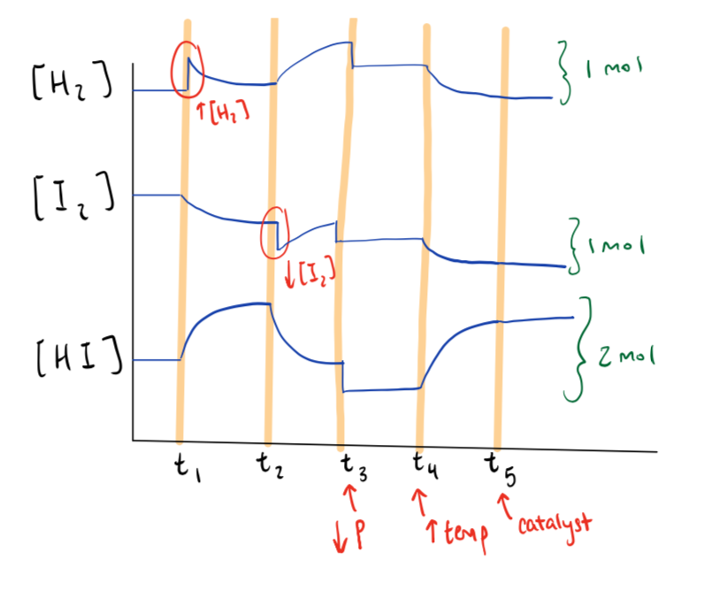
H_{2 (g)} + I_{2 (g)} ⇋ 2 HI _{(g)} ∆H = +187 kJ
Sketch a graph of the relative concentrations of each species as the process outlined below is carried out:
@ t1: Increase the [H₂]
@ t2: Decrease the [I₂]
@ t3: Decrease the total pressure
@ t4: Increase the temperature
@ t5: Add a catalyst

Slide 10
__ NO_{(g)} + __ Cl_{2(g)} ⇋ __ NOCl_{(g)}
When 0.75 mol of NO and 0.30 mol of Cl₂ are placed in a 1.50 L container and allowed to reach equilibrium, 0.24 mol of NOCl are present. From this information, the value of Keq is
What is the value of K_{eq}?
Which side will the equilibrium favour?
0.51
Reactants

Slide 11
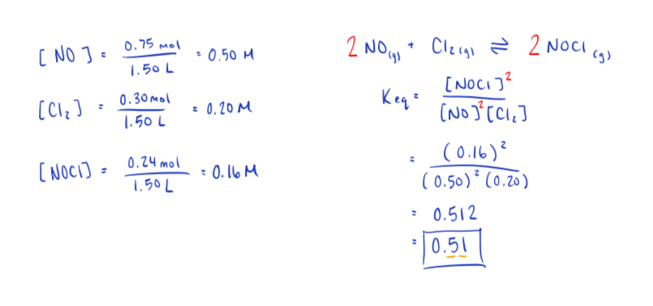

Slide 12
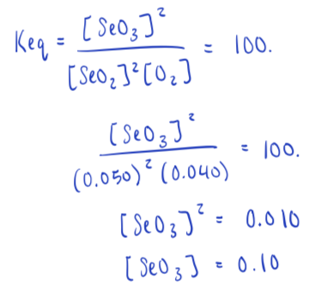
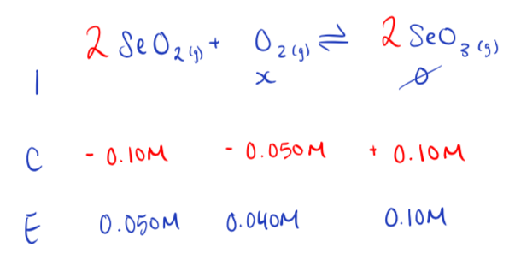
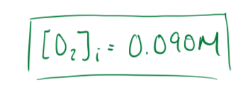
Some SeO₂ and O₂ are injected into a flask. At equilibrium, the [SeO₂] = 0.050M and the [O₂] = 0.040 M. What was the initial [O₂]?
2 SeO_{2 (g)} + O_{2 (g)} ⇋ 2 SeO_{3 (g)} K_{eq} = 100.

Slide 13
Solubility Equilibrium
Final Exam Review

Slide 14
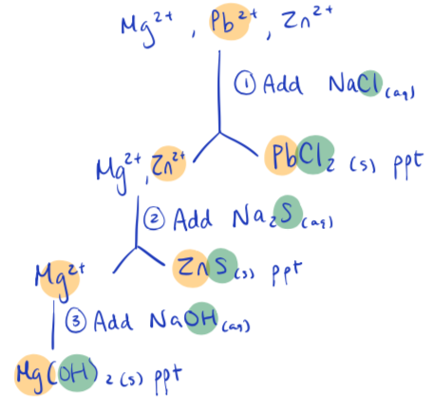
A solution contains Mg²⁺, Pb²⁺, and Zn²⁺. What compounds could be added, and in what order, to precipitate out each ion separately?

Slide 15
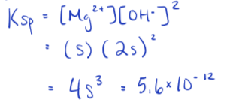
What is the [OH⁻] in a saturated solution of Mg(OH)₂?

Slide 16
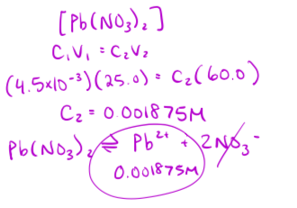
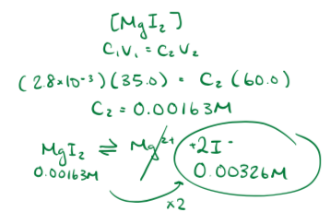
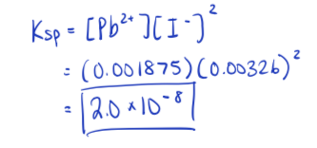
A precipitate just starts to form when 25.0mL of 4.5 x 10⁻³M Pb(NO₃)₂ is mixed with 35.0mL of 2.8 x 10⁻³M MgI₂. What is K_{sp}?

Slide 17
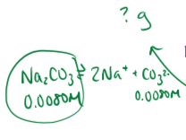
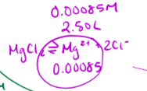
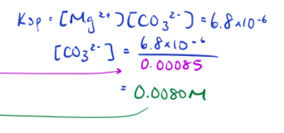
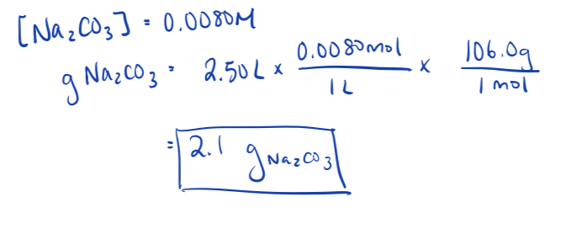
Calculate the mass of Na₂CO₃ that must be added to 2.50 L of 0.00085 M MgCl₂ in order to just start precipitation

Slide 18
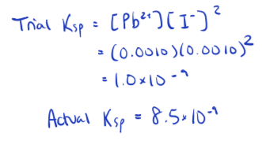
In an experiment, a student mixes equal volumes of 0.0020M Pb(NO₃)₂ with 0.0020M NaI. Will a precipitate form?

Slide 19
Acid-Base Equilibrium
Final Exam Review

Slide 20
[H₃O+] | [OH-] | pH | pOH
7.25 x 10 ⁻¹²
 | 1.82 x 10 ⁻⁷
 |  | 5.8
 |  |  | 11.640
1.38 x 10 ⁻³
11.140
2.860
5.49 x 10 ⁻⁸
7.260
6.740
2 x 10 ⁻⁶
6 x 10 ⁻⁹
8.2
4.37 x 10 ⁻³
2.29 x 10 ⁻¹²
2.360

Slide 21
What mass of NaOH must be added to 500.0 mL of a solution of 0.020 M HI to obtain a solution with a pH = 2.50?

Slide 22
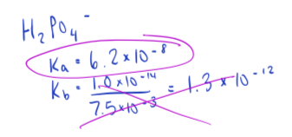
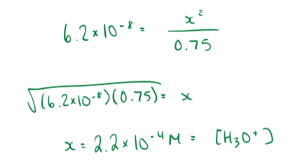
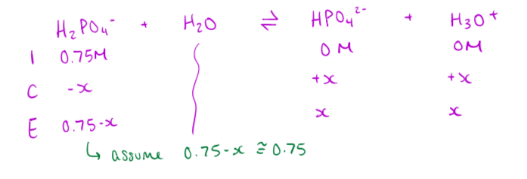
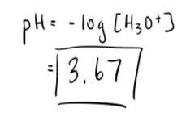
Determine the pH of a 0.75M solution of H₂PO₄⁻

Slide 23
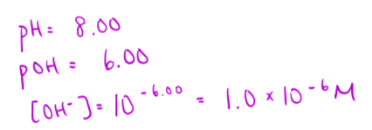
What concentration of NO₂⁻ would be required to produce a solution with pH = 8.00?

Slide 24
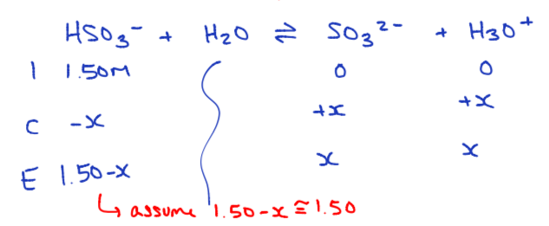
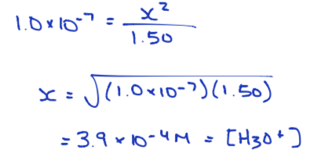
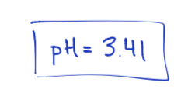
Calculate the pH of the salt Sr(HSO₃)₂ with a concentration of 0.75M

Slide 25
Calculate the pH at equivalence point of a titration when 20.0 mL of 0.200 M NaOH has been added to 20.0 mL of 0.200 M HCOOH

Slide 26
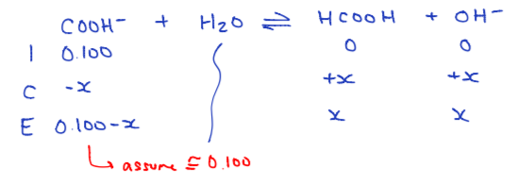
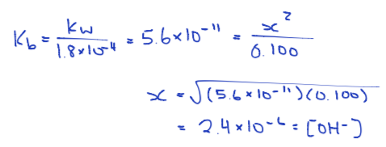
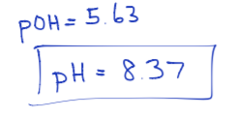

Slide 27
Electrochemistry Equilibrium
Final Exam Review

Slide 28
Balance the following redox reaction: FeHPO₃ + Cr₂O₇²⁻ → Cr³⁺ + H₃PO₄ + Fe³⁺ (basic)

Slide 29
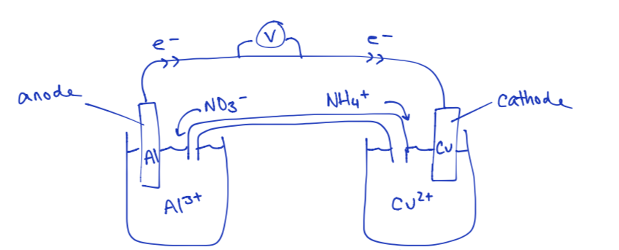
Draw a Cu|Cu²⁺ and Al | Al³⁺ electrochemical cell. Label all parts of the cell, including the voltage produced

