Slide 1
Solutions Review Whiteboards

Slide 2
Molarity – find the missing value
Chemical | Mass | Volume | Molarity
Na₃PO₄ | 15.8 g | 50.0 mL
H₂SO₄ | 94.3 g |  | 3.20 M
CuCl |  | 150.0 mL | 1.48 M
1.93 M
300. mL
22.0 g

Slide 3
How much water needs to be added to 250. mL of 1.25 M NaCl to dilute the concentration to 0.75 M?
V2 = 420 mL – 250. mL = 170 mL water needs to be added

Slide 4
Write Ionization Equations for the following:
K₂S _{( ? )}
Mg(NO₃)₂ _{( ? )}
AgCl _{( ? )}
K₂S_{(aq)} → 2 K⁺ _{(aq)} + S²⁻ _{(aq)}
Mg(NO₃)_{2(aq)} → Mg ²⁺_{(aq)} + 2 NO₃⁻ _{(aq)}
Not possible! AgCl_{(s)} does not ionize

Slide 5
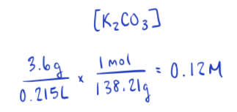
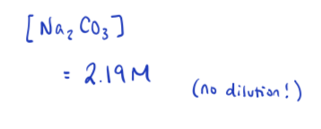
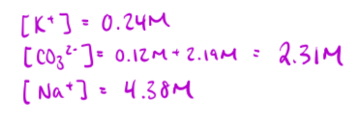
A chemist mixes 215 mL of a 2.9 M Na₂CO₃ solution with 3.6 g of K₂CO₃. What is the concentration of each ion in the solution?

Slide 6
Write the formula, complete, and net ionic equations for the following reactants:
Strontium hydroxide and Sodium sulphate →
Formula equation::
Complete ionic equation:
Net ionic equation:
Sr(OH)₂ _{(aq)} + Na₂(SO₄)_{(aq)} → SrSO_{4(s)} + 2 NaOH _{(aq)}
Sr²⁺_{(aq)} + 2 OH⁻_{(aq)} + 2 Na⁺_{(aq)} + SO₄²⁻ _{(aq)} → SrSO_{4(s)} 2 Na⁺_{(aq)} + 2 OH⁻ _{(aq)}
Sr²⁺_{(aq)} + SO₄²⁻ _{(aq)} → SrSO_{4 (s)}

Slide 7
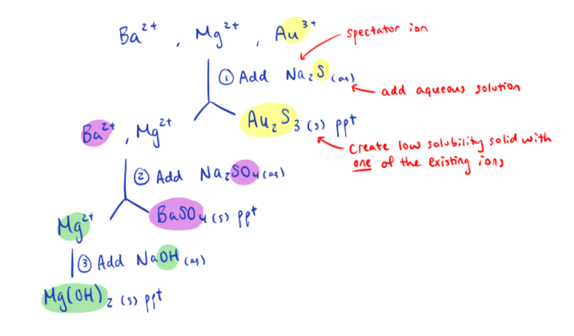
Use a flow chart to precipitate out the following ions:
Ba ²⁺ , Mg ²⁺ , Au ³⁺

Slide 8
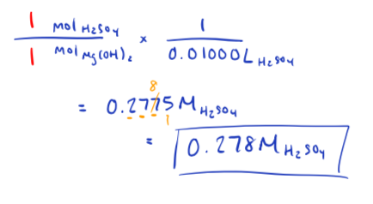
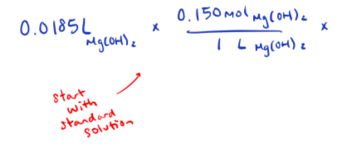
A titration was performed that required 18.5 mL of a 0.150 M Mg(OH)₂ to neutralize 10.00 mL of H₂SO₄. Determine the [H₂SO₄]

Slide 9
Consider the following results from a titration
4.29 g of KOH was dissolved to make 100. mL solution
Below is the volume of KOH solution needed to neutralize 15.0 mL of HCl
What is [HCl]?
 | Trial 1 | Trial 2 | Trial 3 | Trial 4
Initial reading of burette (mL) | 0.00 | 6.40 | 11.75 | 17.15
Final reading of burette (mL) | 6.40 | 11.75 | 17.15 | 22.40

