Slide 1
Earth Science I - II
Review

Slide 2
What does abiotic mean?

Slide 3
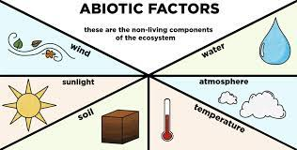
What does abiotic mean?
Non living

Slide 4
What does biotic mean?

Slide 5
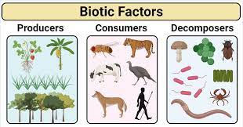
What does biotic mean?
Living

Slide 6
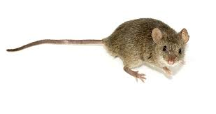
Abiotic or Biotic?

Slide 7
Abiotic or Biotic?
Biotic! It’s a living thing

Slide 8
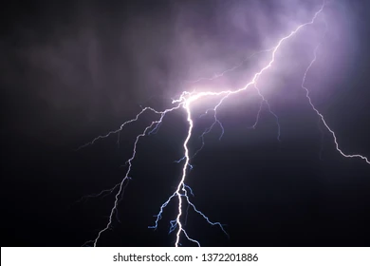
Abiotic or Biotic?

Slide 9
Abiotic or Biotic?
Abiotic! It’s NOT a living thing

Slide 10
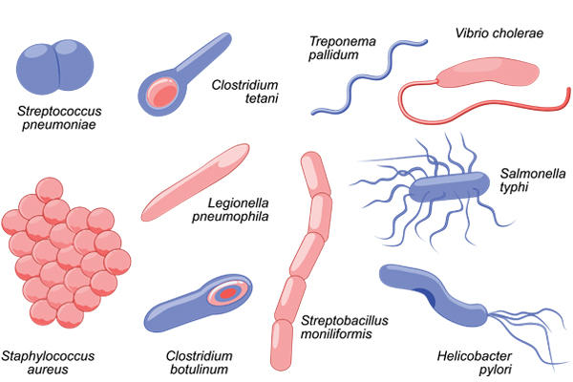
Abiotic or Biotic? : Bacteria - abiotic or biotic?

Slide 11
Abiotic or Biotic? : Bacteria - abiotic or biotic?
Biotic!
They
Are
Living
things!

Slide 12
Earth’s Spheres
Name all 4 of Earth’s spheres

Slide 13
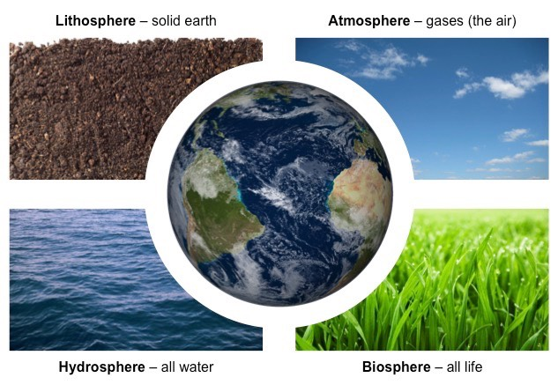
Earth’s Spheres
Name all 4 of Earth’s spheres

Slide 14
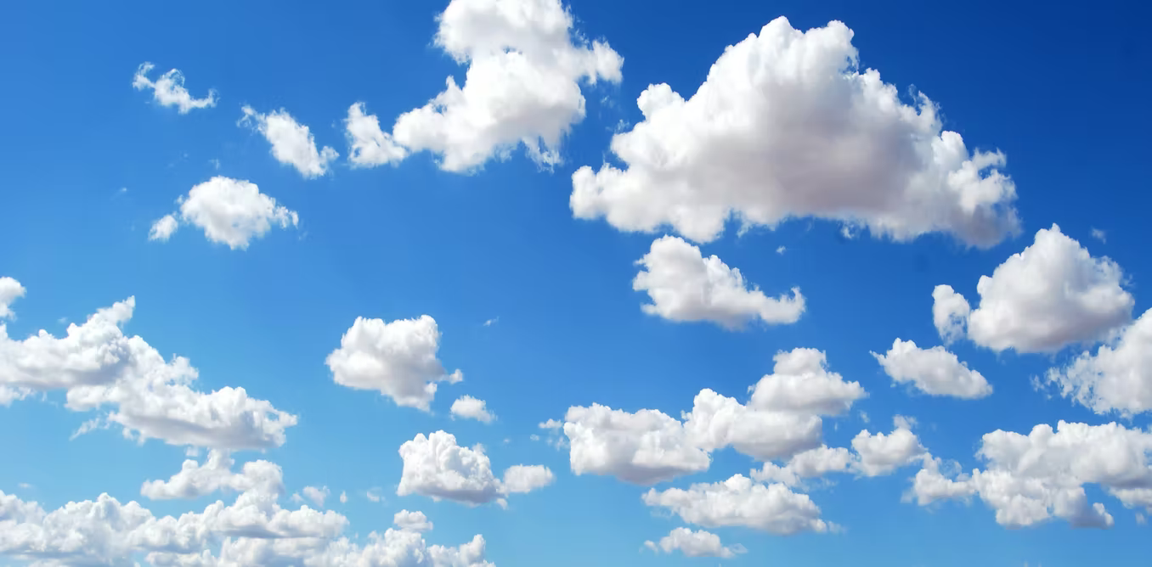
Earth’s Spheres - Which Sphere(s)?
Atmosphere, Hydrosphere, Lithosphere or Biosphere?

Slide 15
Earth’s Spheres- - Which Sphere(s)?
Atmosphere, Hydrosphere, Lithosphere or Biosphere?
Atmosphere (air) & Hydrosphere (water vapour= clouds)

Slide 16
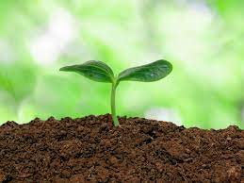
Earth’s Spheres- -Which Sphere(s)?
Atmosphere, Hydrosphere, Lithosphere or Biosphere?

Slide 17
Earth’s Spheres- Which Sphere(s)?
Atmosphere, Hydrosphere, Lithosphere or Biosphere?
soil=lithosphere, plant = biosphere

Slide 18
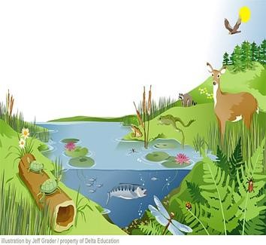
Earth’s Spheres are interconnected! Identify all 4 spheres

Slide 19
Earth’s Spheres are interconnected! Identify all 4 spheres
Atmosphere:
Air/Sky
Hydrosphere:
Lake
Biosphere
Grass
Lily pads
Frogs
Turtles
Deer
Racoon
Dragonfly
Fish (etc)!
Lithosphere
Earth below the grass

Slide 20
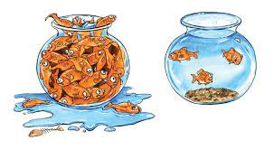
Carrying Capacity & Limiting Factors
What is carrying capacity?

Slide 21
Carrying Capacity & Limiting Factors
What is carrying capacity?
The average population of living things an environment can support.

Slide 22
Carrying Capacity & Limiting Factors
What limits the carrying capacity?

Slide 23
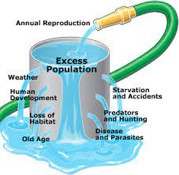
Carrying Capacity & Limiting Factors
What limits the carrying capacity?
Various limiting factors:
-weather
-food
-habitat
-predators
-disease

Slide 24
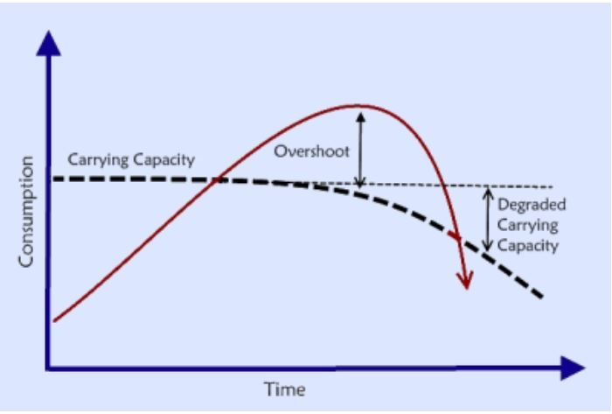
Carrying Capacity & Limiting Factors
What is the overshoot period?

Slide 25
Carrying Capacity & Limiting Factors
What is the overshoot period?
When a population is greater than its carrying capacity

Slide 26
Carrying Capacity & Limiting Factors
What is the impact to the habitat if a population is greater than its carrying capacity?

Slide 27
Carrying Capacity & Limiting Factors
What is the impact to the habitat if a population is greater than its carrying capacity?
The habitat becomes degraded;
The carrying capacity decreases

Slide 28
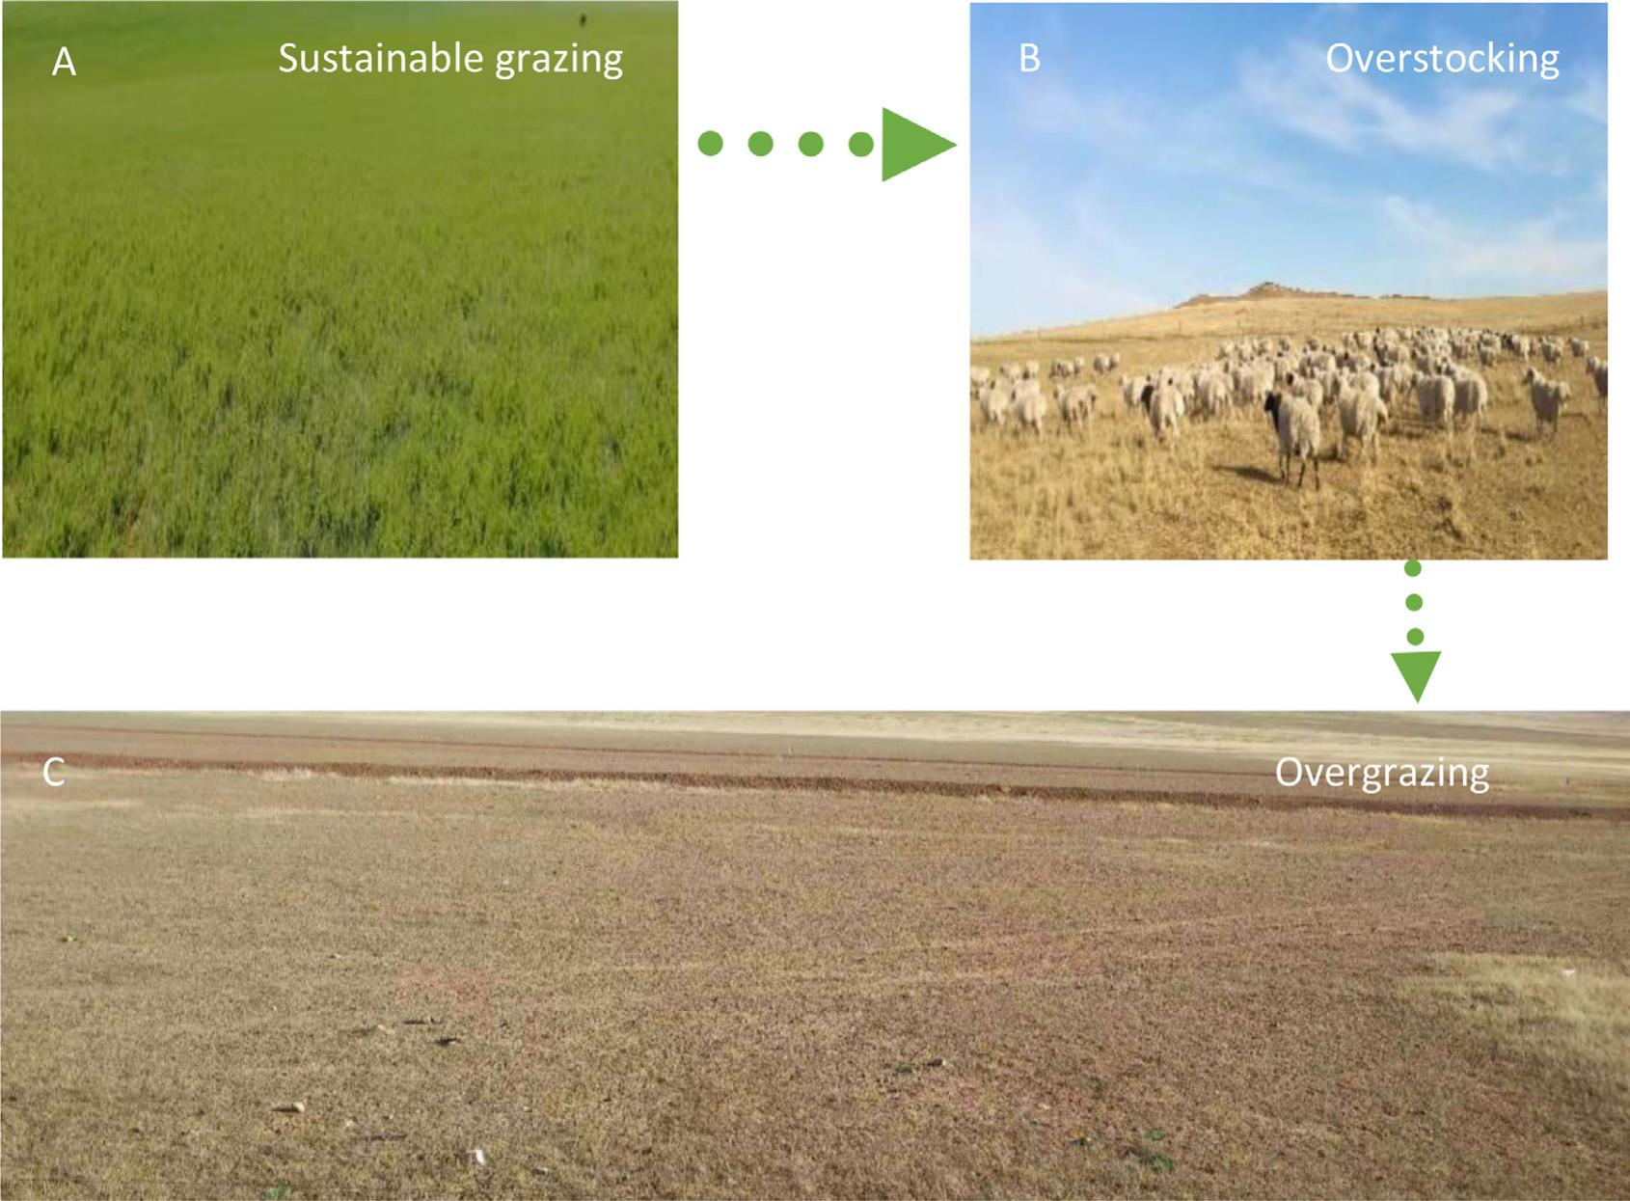
Carrying Capacity & Limiting Factors
What is the impact to the habitat if a population is greater than its carrying capacity?
Over capacity
Degraded habitat
Lower carrying capacity
Over capacity
Degraded habitat
Lower carrying capacity

Slide 29
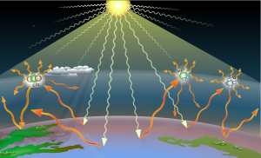
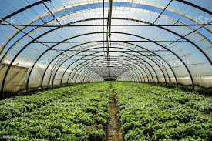
Earth Science 2: Solar Energy
Why are greenhouse gases like a greenhouse?

Slide 30
Earth Science 2: Solar Energy
Why are greenhouse gases like a greenhouse? Both trap heat

Slide 31
Earth Science 2: Solar Energy
What is the most abundant greenhouse gas?
Carbon dioxide
Water vapour
Methane gas
Nitrous oxide

Slide 32
Earth Science 2: Solar Energy
What is the most abundant greenhouse gas?
Carbon dioxide
Water vapour
Methane gas
Nitrous oxide

Slide 33
Earth Science 2: Solar Energy
What is the most abundant greenhouse gas emission?
Carbon dioxide
Water vapour
Methane gas
Nitrous oxide

Slide 34
Earth Science 2: Solar Energy
What is the most abundant greenhouse gas emission?
Carbon dioxide
Water vapour
Methane gas
Nitrous oxide
Greenhouse Gases from Human Activities | Sources
Carbon dioxide | Released from burning fossil fuels (coal, natural gas, oil)
Nitrous oxide | Enters the atmosphere when fertilizers are applied to crops
Methane | Released in large amounts by herds of cattle

Slide 35
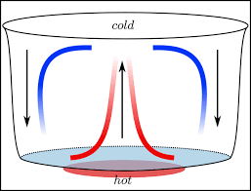
Earth Science 2: Winds
How do convection currents drive winds?

Slide 36
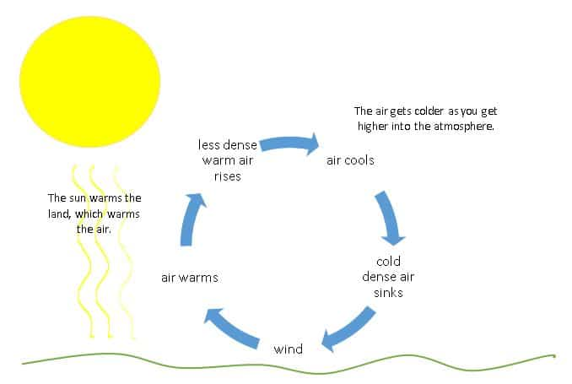
Earth Science 2: Winds
How do convection currents drive winds?
Hot, less dense air rises;
Cool, dense air falls.
These movements create global winds

Slide 37
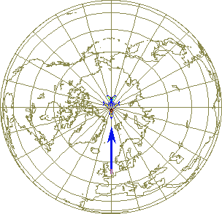
Earth Science 2: Winds
How does the Coriolis effect drive winds?

Slide 38
Earth Science 2: Winds
How does the Coriolis effect drive winds?
-Air near the equator moves faster;
-Air near the poles moves slower;
-When air moves north or south it will
Appear to curve due to this effect
Coriolis explained

Slide 39
Earth Science 2: Winds
There are 3 major global winds- which is type is found in our region?
Trade winds
Westerlies
Polar easterlies

Slide 40
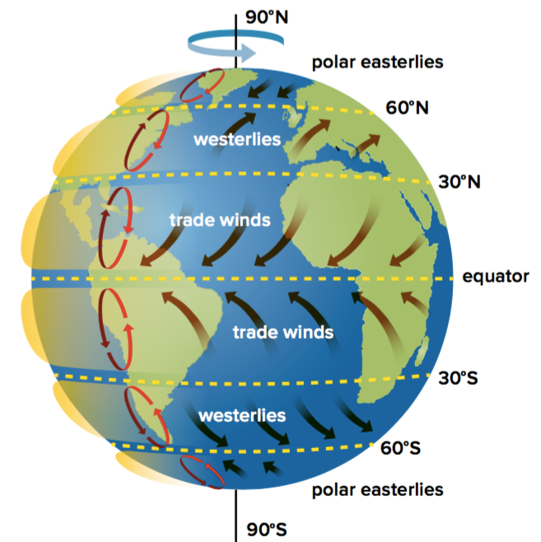
Earth Science 2: Winds
There are 3 major global winds- which is type is found in our region?
Trade winds
Westerlies
Polar easterlies

Slide 41
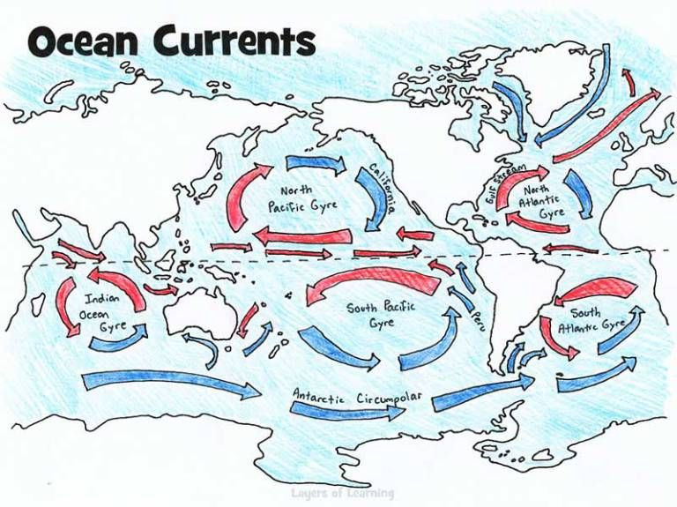
Earth Science 2: Ocean Currents
There are 2 major types of global ocean currents : surface & deep currents
What drives surface currents?

Slide 42
Earth Science 2: Ocean Currents
There are 2 major types of global ocean currents : surface & deep currents
What drives surface currents?
Global winds (they match!)
The Coriolis effect

Slide 43
Want to explore more? Check out this NASA site

Slide 44
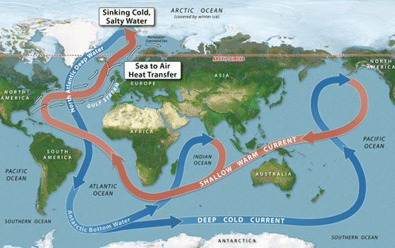
Earth Science 2: Ocean Currents
What’s another name for deep currents?

Slide 45
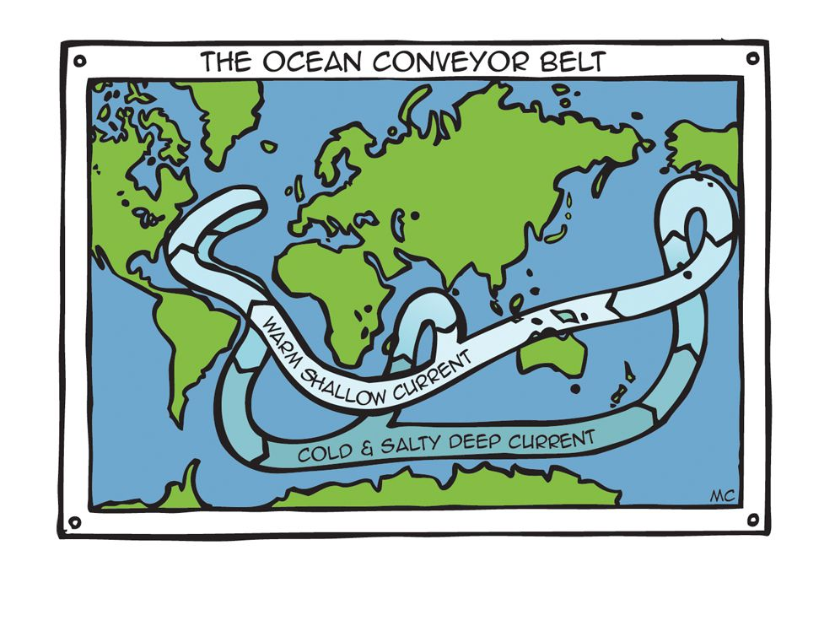
Earth Science 2: Ocean Currents
What’s another name for deep currents?
Great ocean conveyor belt

