Slide 1
Question of the day
Which of the following animals have been successfully cloned?
1. A Sheep
2. A cat
3. A cow
4. all of the above
Notes:
https://www.youtube.com/watch?v=CeWXXWfddIE&t=3s&ab_channel=MinuteEarth

Slide 2
Question of the day
Which of the following animals have been successfully cloned?
1. A Sheep
2. A cat
3. A cow
4. all of the above
Notes:
https://www.youtube.com/watch?v=CeWXXWfddIE&t=3s&ab_channel=MinuteEarth

Slide 3
Microscope Lab

Slide 4
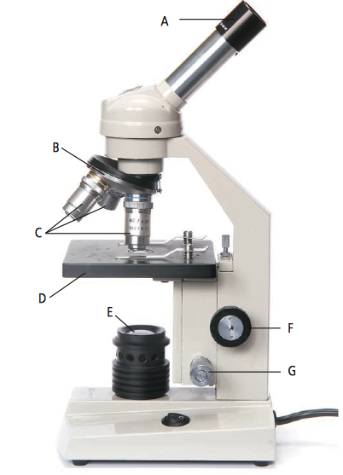
Parts of a Microscope
A: Eyepiece
B: Revolving nose piece
C: Objective lens
D: Stage
E: Light source
F: Coarse focus knob
G: Fine focus knob

Slide 5
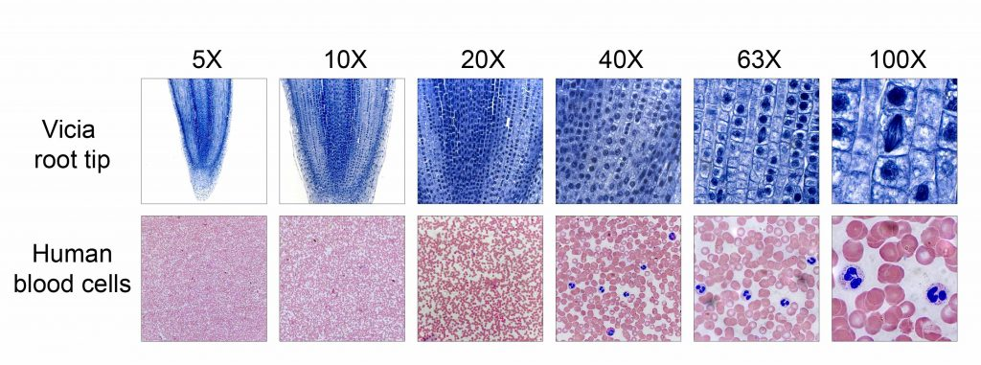
Magnification
Magnification:
Degree of visual enlargement of an observed object
The microscopes we will be using are 10x (medium) or 40x (high) magnification
What are the magnifications we will be using today?

Slide 6
Carrying a Microscope
One hand on the arm, one hand under the base

Slide 7
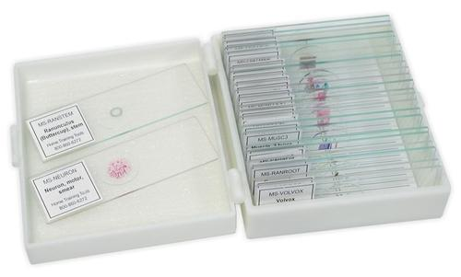
Microscope Slides
They are made of glass so be careful when handling them
Watch out for the edges! They are sharp
Please only hold them by the edges, do not hold them where the specimen is
Specimen

Slide 8
Microscope care
Be careful with the microscope and the slides and do not damage them in any way
When on high (40x) magnification, only use the fine focus knob
Once you are finished using the microscope, please unplug it by pulling on the plug and not the wire
Wrap the wire around the microscope base and place the protective cover over it.
Return all slides once you are finished looking and drawing
Which focus knob do you use when on high magnification?
How do you unplug a microscope?

Slide 9
Safety!
If you drop and break a microscope slide, DO NOT touch the broken glass!
Get a broom and dustpan and sweep it up
Inform the teacher and dispose of the slide into the broken glass bucket

