Slide 1
Meiosis Whiteboards

Slide 2
Nuclear membrane disappears; DNA condenses into duplicated chromosomes; homologous chromosomes are paired
Prophase I

Slide 3
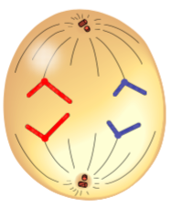
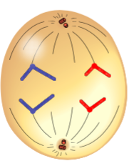
Anaphase II

Slide 4
Two nuclei form and each nucleus contains a complete copy of the cell’s DNA; the cell divides into two cells
Telophase I

Slide 5
Nuclear membrane disappears; DNA exists as chromosomes
Prophase II

Slide 6
Homologous chromosome pairs separate and go to each end of the cell
Anaphase I

Slide 7
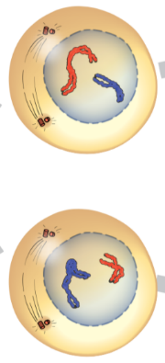
Prophase II

Slide 8
Chromosomes line up along the middle of the cells
Metaphase II

Slide 9
Four nuclei form; the cells divide, forming four new cells
Telophase II

Slide 10
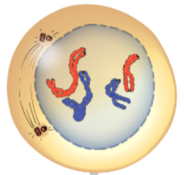
Prophase I

Slide 11
Sister chromatids are separated and go to each end of the cell
Anaphase II

Slide 12
Spindle fibres guide chromosome movement; homologous chromosome pairs line up along the middle of the cell
Metaphase I

Slide 13
Crossing over occurs
Prophase I

Slide 14
The cytoplasm of a cell divides, forming four haploid gametes
Cytokinesis

Slide 15
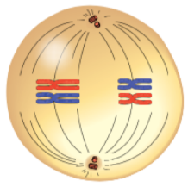
Metaphase I

