Slide 1
Where is most of earth’s biodiversity (land based) found?
1. Near the equator
2. In the southern hemisphere
3. In Asia
4. In the northern hemisphere

Slide 2
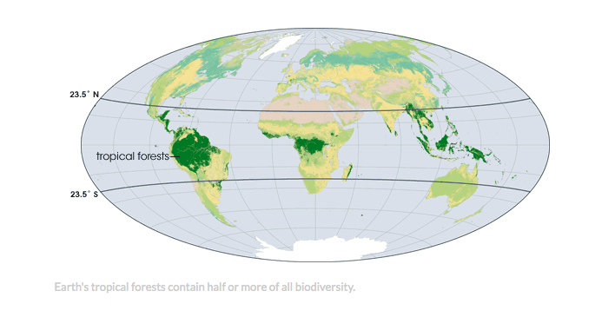
Where is most of earth’s biodiversity (land based) found?
1. Near the equator
2. In the southern hemisphere
3. In Asia
4. In the northern hemisphere
https://www.youtube.com/watch?v=mWVATekt4ZA

Slide 3
Earth Science V
Nitrogen Cycle
Phosphorus Cycle

Slide 4
Video
https://www.youtube.com/watch?v=NHqEthRCqQ4&ab_channel=AmoebaSisters
Notes:
Start at 4:00 min

Slide 5
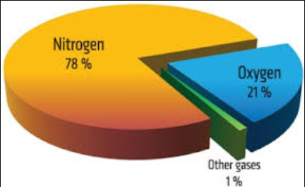
Nitrogen Cycle
Nitrogen is an important nutrient needed by all cells; it is a key building block for proteins.
Nitrogen makes up 78% of the air, however, most living things cannot use the nitrogen found in the air.

Slide 6
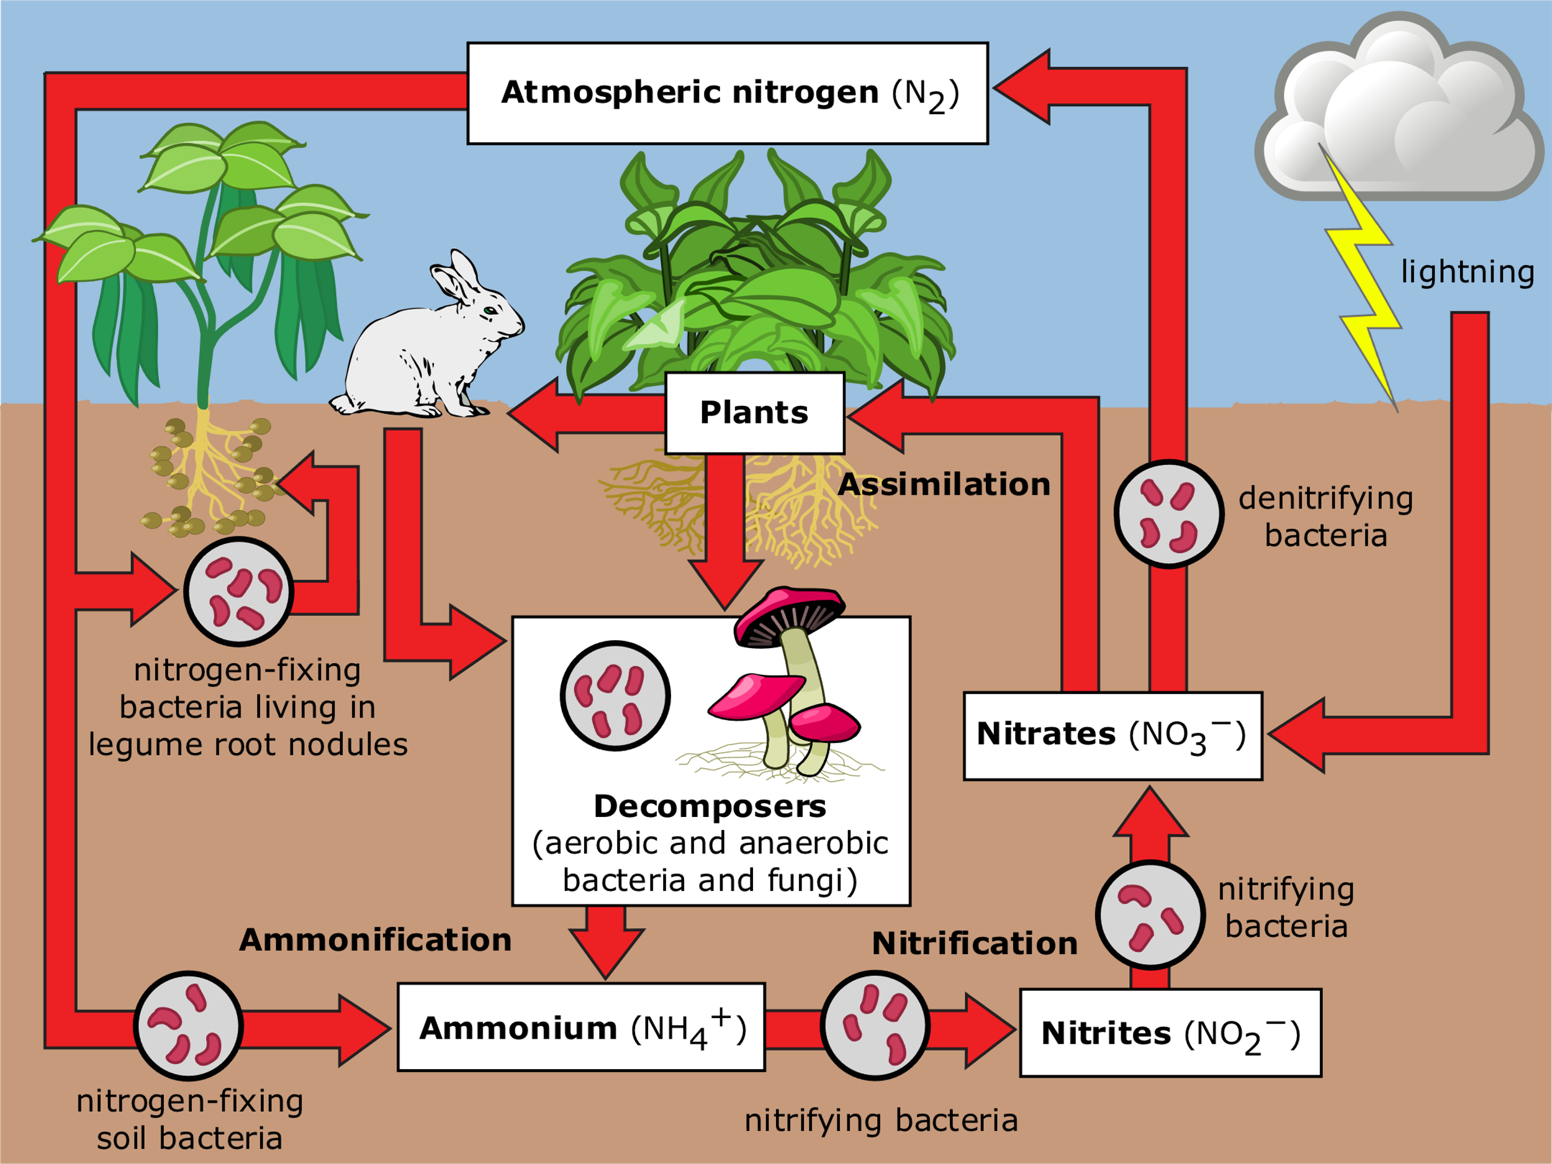
Nitrogen Cycle
Nitrogen-fixing bacteria, located in the water and soil, changes the nitrogen in the air (N₂ gas) into a form that plants are able to use (ammonium, nitrite, and nitrate).
Once nitrogen is taken up by a plant, it then can be transferred to other organisms through the food chain.
Nitrogen will return back into the soil once an organism is decomposed through the help of decomposers.

Slide 7
Nitrogen Cycle
Lightning can also help nitrogen go into the soil for plants to take up.
When lightning occurs, the energy breaks the nitrogen molecules and allows its molecules to combine with oxygen.
This will dissolve in rain to form nitrates which will then be carried onto the Earth.

Slide 8
Nitrogen Cycle
Denitrification can also occur where nitrate is converted back into nitrogen gas; this will return nitrogen back into the atmosphere.
This process if done by denitrifying bacteria.

Slide 9
Practice Questions
1. Give an example of how nitrogen moves from an abiotic portion of the environment to a biotic portion
Nitrogen is found in the air (abiotic) as nitrogen gas and is changed into ammonium, nitrite, and nitrate in the soil which can then be taken up by plants (biotic)
2. Why are bacteria an important part of the nitrogen cycle?
Nitrogen-fixing bacteria change nitrogen gas into usable forms in the soil; denitrifying bacteria change nitrogen in the soil back into nitrogen gas

Slide 10
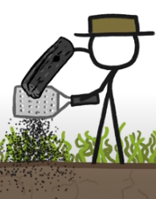
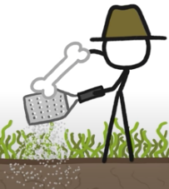
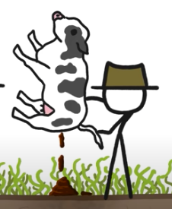
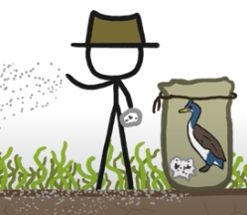
In the 1840s, what did farmers add to improve soil quality for crop growing?
1. Wood ash
2. Bones
3. Cow manure
4. Bird poop

Slide 11
In the 1840s, what did farmers add to improve soil quality for crop growing?
1. Wood ash
2. Bones
3. Cow manure
4. Bird poop
https://www.youtube.com/watch?v=ARU1WbtO7qQ&ab_channel=MinuteEarth

Slide 12
Video
https://www.youtube.com/watch?v=wdAzQSuypCk&ab_channel=dsec208

Slide 13
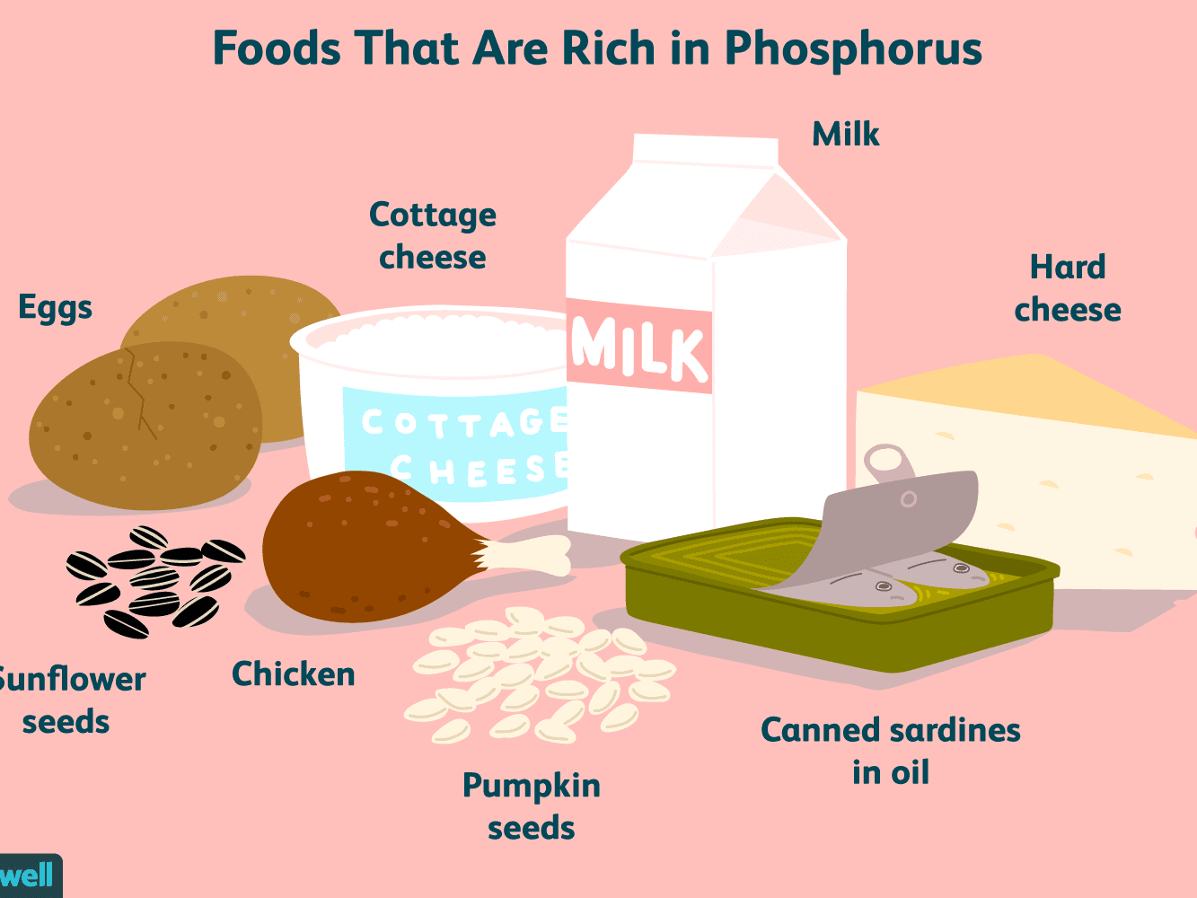
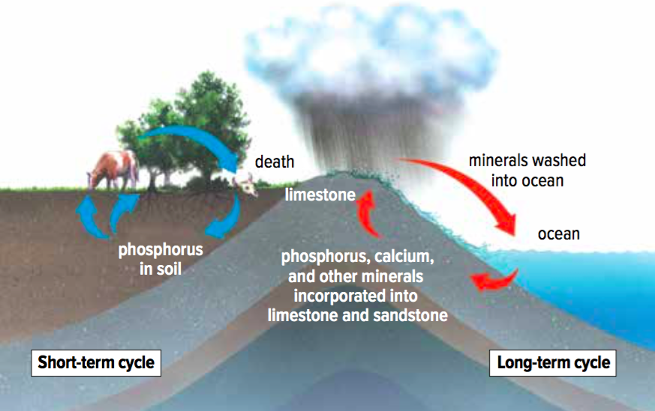
Phosphorus Cycle
Phosphorus is an essential nutrient for the growth and development of organisms.
Phosphorus is stored in the lithosphere.
Rocks from underground can be brought to the surface through geological uplift.
When rock is broken down by weathering (such as rain, wind, snow, etc.), phosphorus is released into the soil and water.

Slide 14
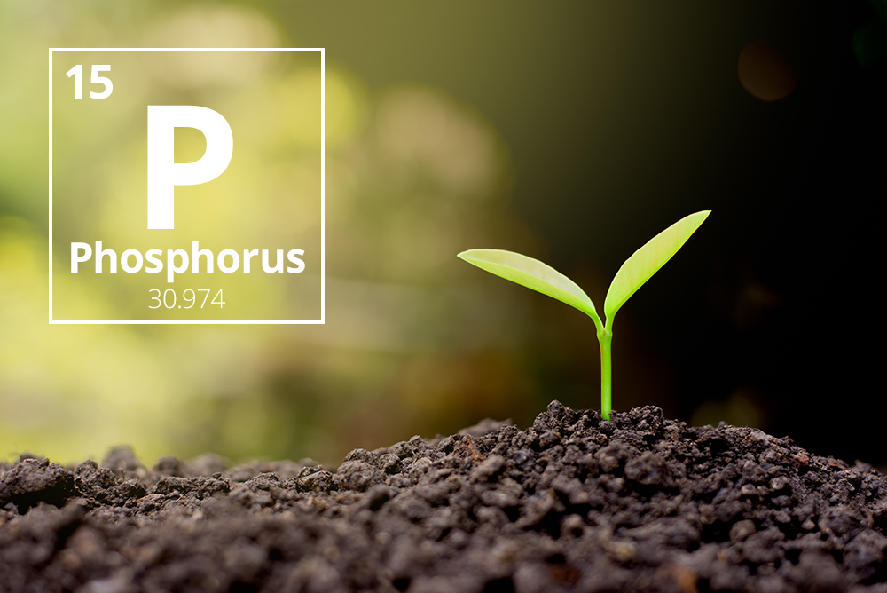
Phosphorus Cycle
Plants and plant-like organisms can take up the phosphorus which is then transferred to other organisms through the food chain.
Decomposers can then return the phosphorus into the soil and water as they break down organisms.
Phosphorus is the only cycle that is not present in the atmosphere.

Slide 15
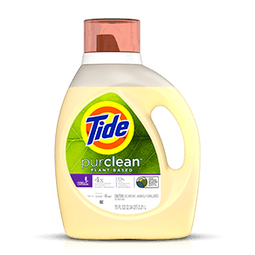
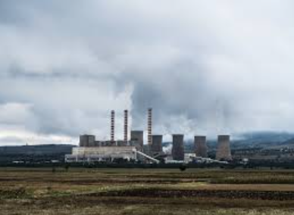
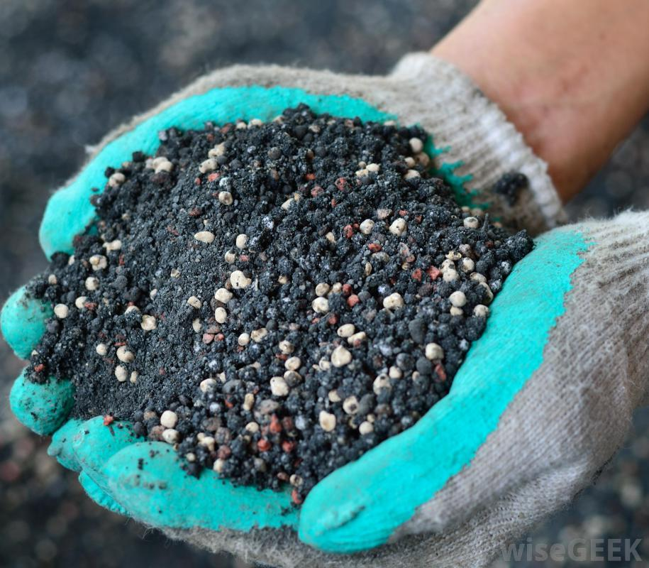
Excess Nitrogen and Phosphorus
How have humans impacted the nitrogen and phosphorus cycle?
Nitrogen is commonly found in fossil fuels and fertilizers. When fossil fuels are burned, excess nitrogen oxide enters into the atmosphere.
Phosphorus is commonly found in dishwashing and laundry detergents. It is also a common ingredient of fertilizers.

Slide 16
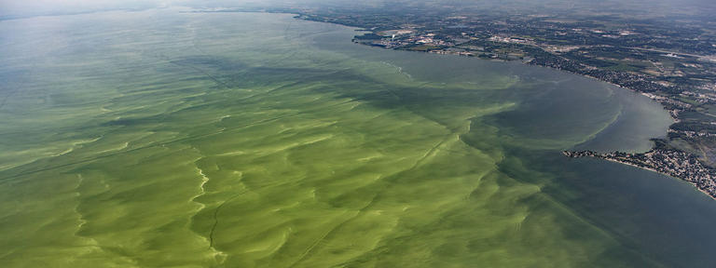
Excess Nitrogen and Phosphorus
When fertilizers are used by farmers and gardeners to help plants grow, some of the nitrates (present in fertilizers) and phosphorus is not used by the plants.
When it rains or when the plants are watered, some of the nitrogen and phosphorus can be carried into the water ecosystem.
This has caused a phenomenon called an algal bloom which results when there is an excess amount of nitrogen and phosphorus that causes an overgrowth of algae.

Slide 17
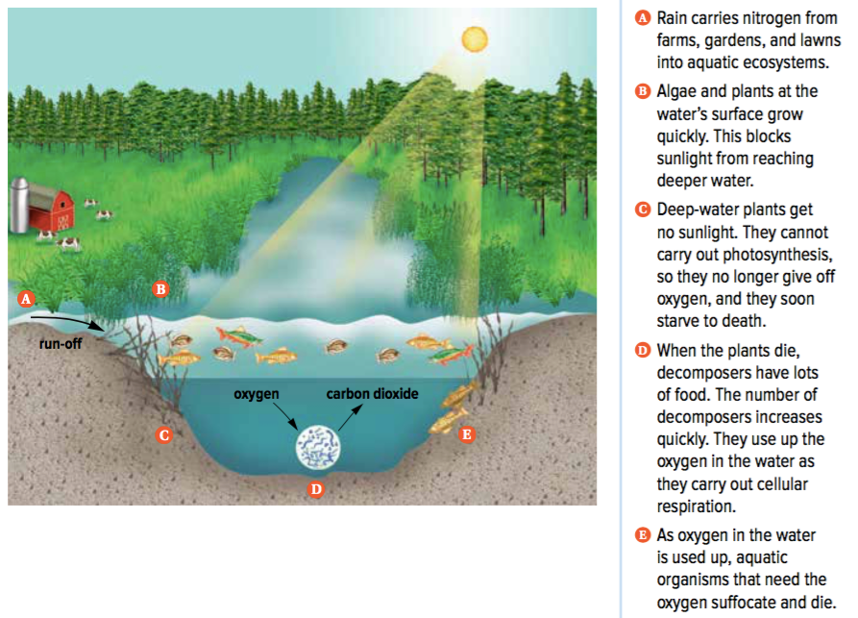
Algal Bloom
An algal bloom will cause a chain reaction of events to occur in the aquatic ecosystem:
Algae is located on the surface of the water. When an overgrowth of algae occurs on the surface of the water, it blocks sunlight from reaching the deep water.
This will result in deep-water plants getting no sunlight which will prevent them from being able to photosynthesize and create oxygen in the water.

Slide 18
Algal Bloom
When these plants die, decomposers will be able to break down these plants which will cause the decomposer population to grow quickly and use all of the oxygen present in the water.
As oxygen is used up, aquatic organisms that require oxygen to survive will not have enough and die off.

