Slide 1
Electrochemistry
Whiteboard Review

Slide 2
Oxidation Numbers
N₂H₅⁺
BrO₃⁻
Cr(OH)₄
S₈
N = -2 H = +1
Br = +5 O = -2
Cr = +4 O = -2 H = +1
S = 0

Slide 3
Balance this redox reaction:
U⁴⁺ + MnO₄⁻ --> Mn²⁺ + UO₂²⁺
2 H₂O + 5 U⁴⁺ + 2 MnO₄⁻ → 5 UO₂²⁺ + 4 H⁺ + 2 Mn²⁺
Which species is your oxidizing agent?
MnO₄⁻

Slide 4
Balance this redox reaction:
Cl₂ + SO₂ → Cl⁻ + SO₄²⁻ (basic)
4 OH⁻ + Cl₂ + SO₂ → 2 Cl⁻ + SO₄²⁻ + 2 H₂O
Which species is your reducing agent?
SO₂

Slide 5
Classify the following combinations as spontaneous, non-spontaneous, or no reaction. If spontaneous, write out the complete reaction and calculate the cell potential
Sn⁴⁺ + 2e⁻ → Sn²⁺ E∘ = + 0.15 V
Al → Al³⁺ + 3e⁻ E∘ = +1.66 V 3 Sn⁴⁺ + 2Al → 3 Sn²⁺ + 2 Al³⁺ E∘ total = +1.81 V (spont)
Sn⁴⁺ and Al
Al³⁺ and Ni²⁺
Cu(NO₃)₂ and Ag⁺
I⁻, Pb, and Sn²⁺
No reaction (both OA)
No reaction (Cu²⁺ and Ag⁺ both OA, NO₃⁻ spectator)
Sn²⁺ + 2e⁻ → Sn E∘ = - 0.14 V
Pb → Pb²⁺ + 2e⁻ E∘ = +0.13 V Sn²⁺ + Pb → Pb²⁺ + Sn E∘ total = - 0.01 V (Nonspont)

Slide 6
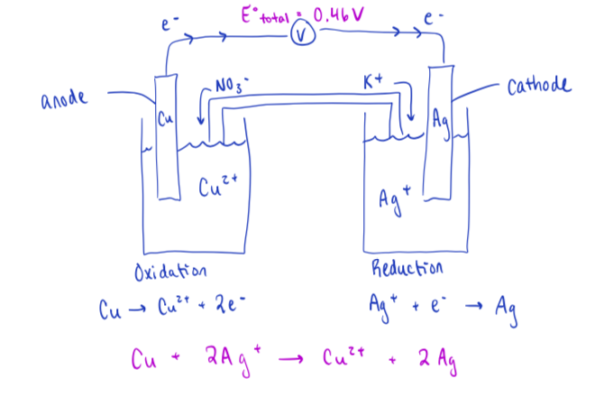
An electrochemical cell is constructed using Ag/Ag⁺ and Cu/Cu²⁺ half cells
Draw the electrochemical cell
Which electrode will lose mass?
Cu_{(s)} will lose mass

Slide 7
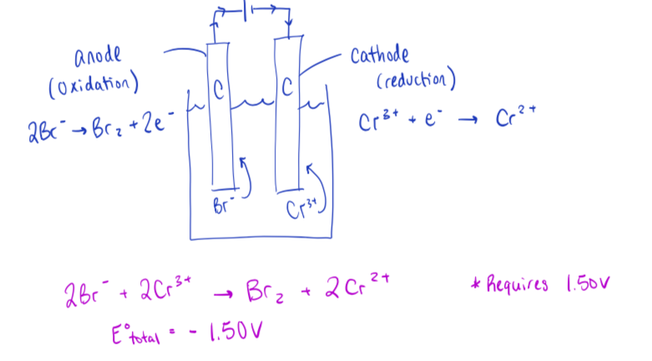
An electrolytic cell is constructed using carbon electrodes in CrBr_{3(aq)}
Draw the electrolytic cell, including the half-reactions occurring within it

