Slide 1
Mole Unit Review

Slide 2
How many sig figs are in each of the following numbers?
1.22
900.0035
0.00000506
400.00
0.0005000
61 000
2.000 x 10⁴
3
7
3
5
4
2
4

Slide 3
Acetaminophen is a widely used nonprescription medication for mild-to-moderate pain and fever. It is marketed as Tylenol. The molecular formula for acetaminophen is C₈H₉NO₂
a. Calculate the molar mass of acetaminophen
b. How many moles are present in 10.0 g of acetaminophen?
c. Calculate the mass in grams of 1.56 mol of acetaminophen
d. How many molecules are in 5.0 mg of acetaminophen? (1000 mg = 1 g)
151.18 g/mol
0.0661 mol
236 g
2.0 x 10¹⁹ molecules

Slide 4
Calculate each of the following
What is the mass of 0.125 mol of CO₂?
What is the molar mass of a 0.075 mol sample that weighs 3.0 g?
What is the volume of 6.54 x 10⁻⁴ mol of HCN at STP?
How many atoms are in 15.4 mol of Ni(OH)₂ ?
5.50 g
40. g/mol
0.0146 L
4.64 x 10²⁵ atoms

Slide 5
How many grams of CaCl₂ are contained in 225 mL of a 0.0350M CaCl₂ solution?

Slide 6
An experiment is conducted to calculate the molar volume of oxygen gas. The following data is collected:
Calculate the molar volume of O₂ at 21.0ºC and 100.4 kPa using the data.
Moles of O₂ gas | 0.00145 mol
Volume of O₂ collected | 44.5 mL
Room temperature | 21.0ºC
Pressure | 100.4 kPa
30.7 L / mol

Slide 7
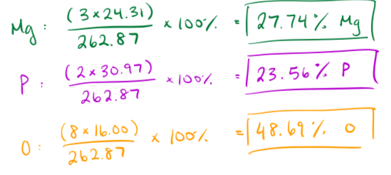
Calculate the percentage composition of each atom in magnesium phosphate

Slide 8
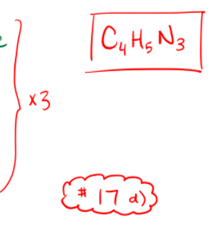
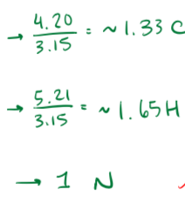
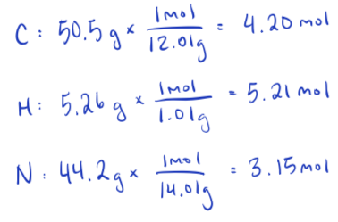
Find the empirical formula for a compound that is composed of 50.5% carbon, 5.26% hydrogen, and 44.2% nitrogen

Slide 9
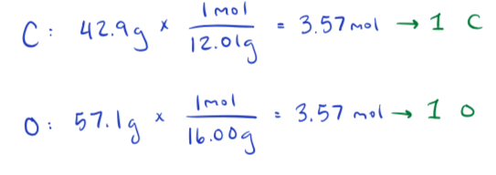
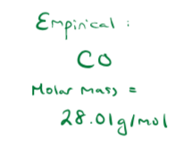
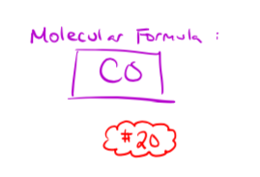
0.0600 mol of a gas containing carbon and oxygen has a mass of 1.68g. If the gas is 42.9% carbon, what is the molecular formula of this gas?

