Slide 1
Stoichiometry Review Whiteboards

Slide 2
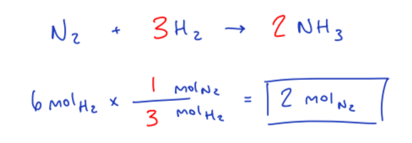
How many moles of nitrogen are required to react with 6 mol of hydrogen according to the equation:
___ N₂ + ___ H₂ → ___ NH₃

Slide 3
How many grams of Ni are produced when 77.9 g of Aluminium reacts with an excess of Nickel (II) bromide?
2 Al + 3 NiBr₂ → 2AlBr₃ + 3 Ni

Slide 4
What volume of CH₄ at STP is required to produce 24.3 g of H₂O?
CH₄ + 2 O₂ → CO₂ + 2 H₂O

Slide 5
What mass of NaOH is contained in 7.50L of 0.400M of NaOH

Slide 6
Part 1
If 25.4 g of Al₂O₃ is reacted with 10.2 g of Fe, determine the mass of Al produced
4 Al₂O₃ + 9 Fe → 3 Fe₃O₄ + 8 Al

Slide 7
Part 2
If 25.4 g of Al₂O₃ is reacted with 10.2 g of Fe, how much excess reactant will be left over?
4 Al₂O₃ + 9 Fe → 3 Fe₃O₄ + 8 Al

Slide 8
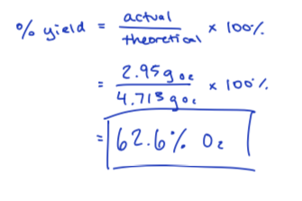
10.45 g of sodium chlorate is decomposed and forms sodium chloride and 2.95 g of oxygen gas. Calculate the percentage yield of oxygen gas
2 NaClO₃ → 2 NaCl + 3 O₂

Slide 9
In an experiment, 3.44 g of 90.0% pure H₂ and 6.25 g of 80.0% pure O₂ are placed in a reaction vessel. The introduction of a 120 kJ spark generates water
a) Is this reaction endothermic or exothermic?
b) What is the balanced reaction? Include energy
c) What is the limiting reactant?
Endothermic
2 H₂ + O₂ + 120 kJ→ 2 H₂O
O₂

